Slide 1
EEG in the ICU Quiz
March 2012
Teneille E. Gofton

Slide 2
Quiz
The next several slides will show 15 subhairline EEGs. Choose the best possible answer in each scenario. Your score and solutions will be provided at the conclusion of the quiz.

Slide 3
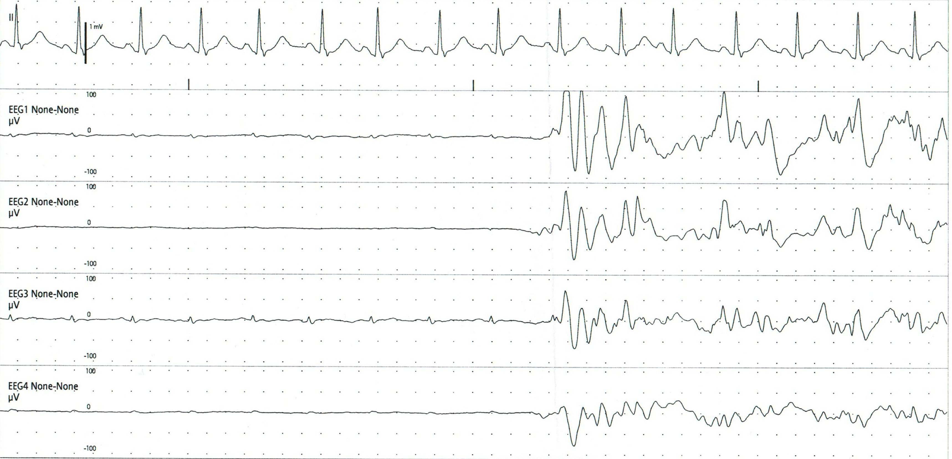
1
The following subhairline EEG represents:
Suppression-burst pattern
Seizure
Movement artifact
Chest physiotherapy artifact

Slide 4
1
The following subhairline EEG represents:
Suppression-burst pattern
Seizure
Movement artifact
Chest physiotherapy artifact

Slide 5
1
Period of suppression
Burst of cerebral activity

Slide 6
1
This is not a seizure because there is no repetitive pattern or evolution (progressive change in voltage/amplitude and frequency) of the EEG activity.
This is not movement artifact because it is not intermittent and because there is nota accompanying change in the EKG.

Slide 7
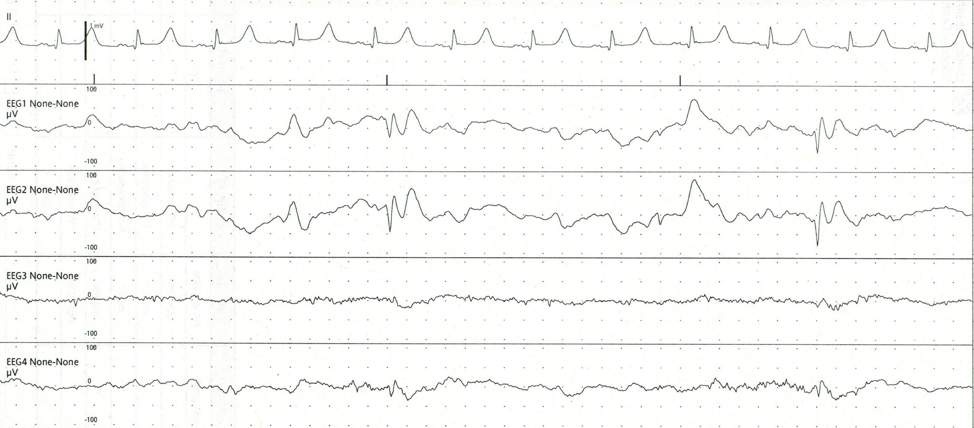
2
The following subhairline EEG represents:
Periodic lateralised epileptiform discharges (PLEDs)
EKG artifact
Epileptic spike
Delta wave with EKG artifact

Slide 8
2
The following subhairline EEG represents:
Periodic lateralised epileptiform discharges (PLEDs)
EKG artifact
Epileptic spike
Delta wave with EKG artifact

Slide 9
2
These are the discharges of interest in this epoch.
This discharge consists of a narrow electronegative spike followed by a longer lasting aftercoming slow wave. This is a spike-and-wave complex, an epileptiform discharge.

Slide 10
2
Left frontal
Right frontal
Left temporal
Right temporal
This discharge of interest occurs in both hemispheres. Therefore, it is not a lateralised (unilaterally occurring) discharge.
The discharge does not occur at the same intervals as the EKG.
While the discharge contains a delta wave, the preceding spike occurs prior to each delta.

Slide 11
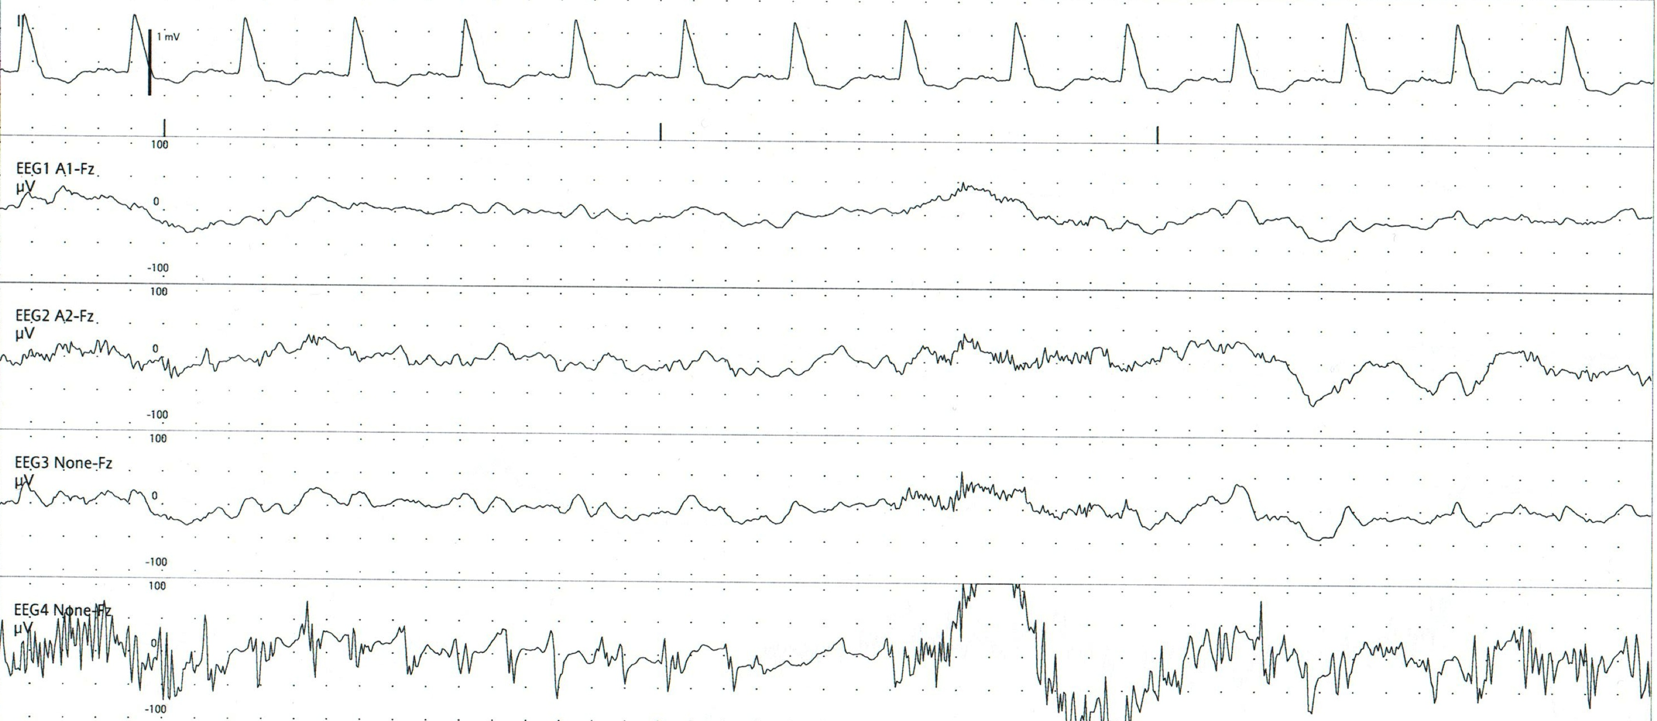
3
The following subhairline EEG represents:
Epileptiform spikes
Right sided periodic lateralised discharges (PLEDs)
Epileptic seizure
Electrode artifact

Slide 12
3
The following subhairline EEG represents:
Epileptiform spikes
Right sided periodic lateralised discharges (PLEDs)
Epileptic seizure
Electrode artifact

Slide 13
3
Left frontal
Right frontal
Left temporal
Right temporal
These are not epileptiform spike-and-wave discharges because they are too narrow and there is no aftercoming slow wave.
These are not periodic lateralised epileptiform discharges because they only occur in one of the two right-sided electrode derivations.

Slide 14
3
Left frontal
Right frontal
Left temporal
Right temporal
This is not a seziure because it only occurs in one single electrode derivation and there is not evolution (changing amplitude/voltage or frequency).
This is artifact because it is only seen in a single electrode derivation and in a single right sided lead.

Slide 15
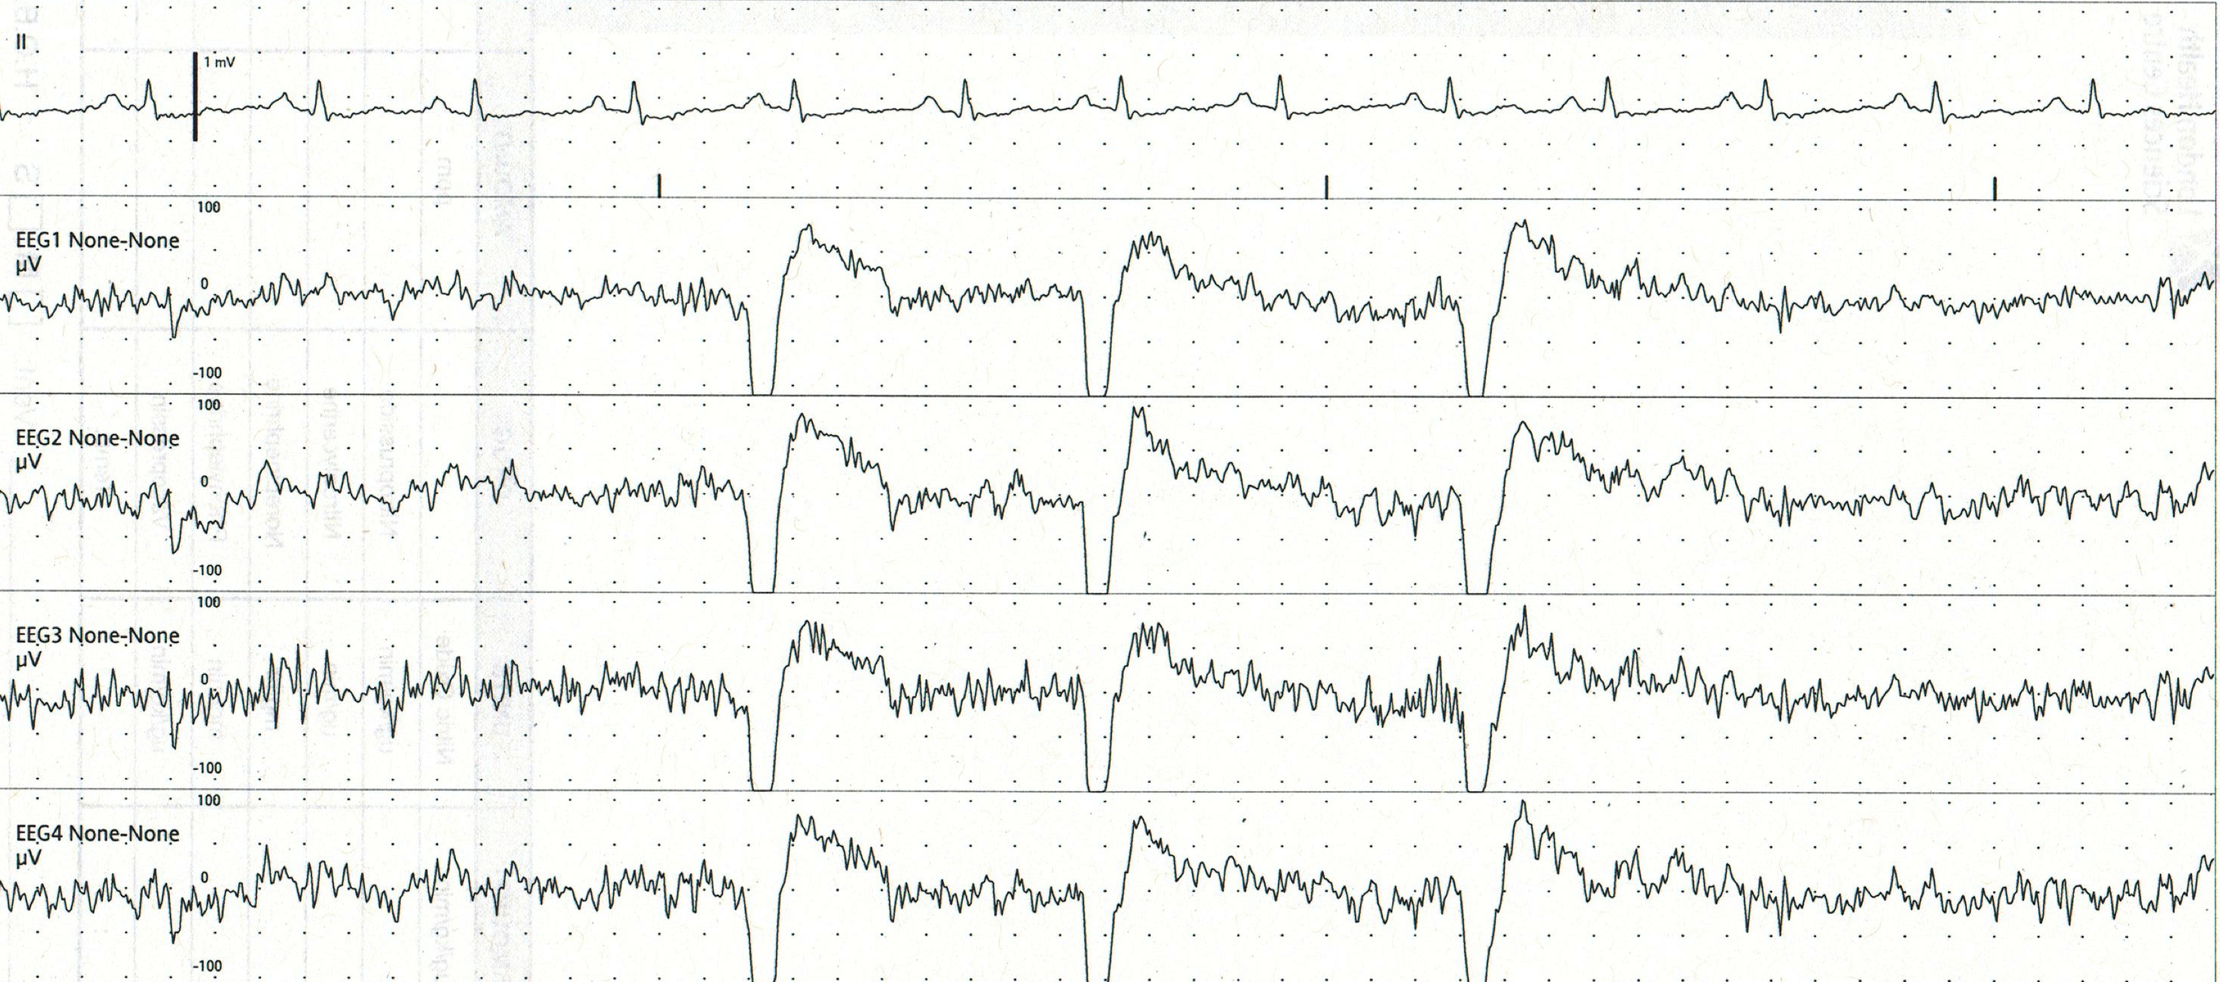
4
The following subhairline EEG represents:
Generalised periodic epileptiform discharges (GPEDs)
Eye blink artifact
Epileptic spike-and-wave
Triphasic waves

Slide 16
4
The following subhairline EEG represents:
Generalised periodic epileptiform discharges (GPEDs)
Eye blink artifact
Epileptic spike-and-wave
Triphasic waves

Slide 17
4
These are electropositive stereotyped artifacts seen with eye blinking.
This is not a spike-and-wave complex because the electropositive component is too broad and there is no aftercoming slow wave.
This is not a triphasic wave because there are not three clear phases within the waveform.

Slide 18
5
True or false?
Triphasic waves are only associated with hepatic encephalopathy.

Slide 19
5
True or false?
Triphasic waves are only associated with hepatic encephalopathy.
False.
Triphasic waves are seen in many forms of metabolic encephalopathy. They were first described in the setting of hepatic encephalopathy, but can also be seen in conditions such as renal failure and sepsis.
In severe encephalopathy triphasic waves may not be seen because of the degree of suppression of cerebral activity.

Slide 20
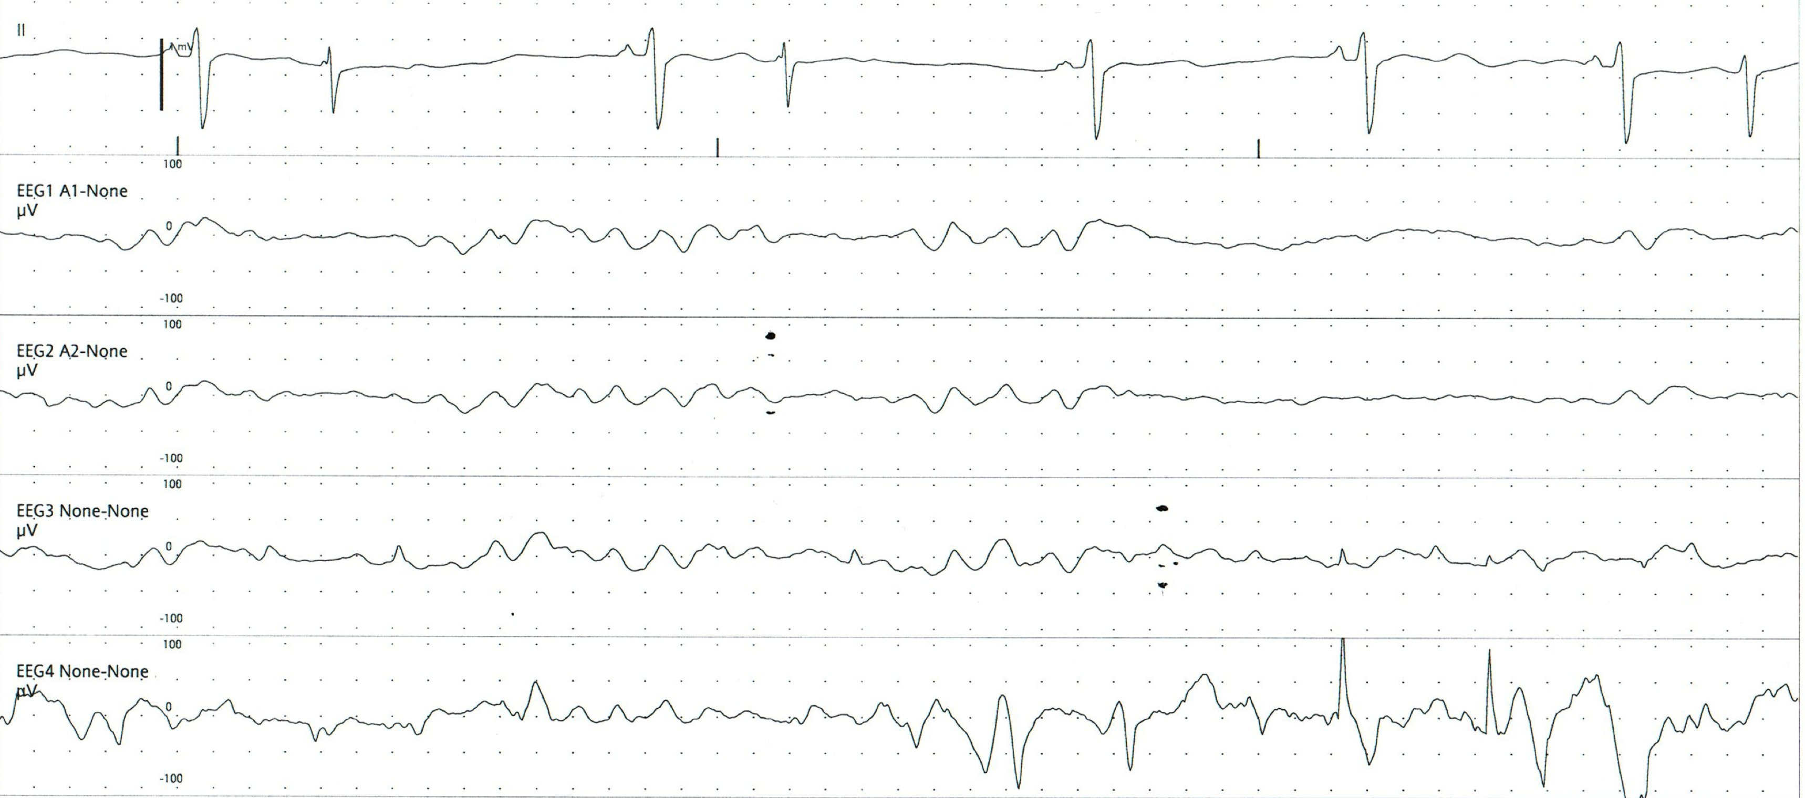
6
The following subhairline EEG demonstrates:
A normal subhariline EEG
A focal seizure
A normal subhairline EEG with artifact
Burst suppression

Slide 21
6
The following subhairline EEG demonstrates:
A normal subhariline EEG
A focal seizure
A normal subhairline EEG with artifact
Burst suppression

Slide 22
6
The entire tracing is artifactual in the 4th channel. The information from this tracing is not reliable. Abnormal activity seen in one right sided channel should be at least partially reflected in the other right sided channel. The artifact is most likely secondary to poor electrode contact with the skin.
The first three electrode derivations demonstrate a relatively normal subhairline EEG.

Slide 23
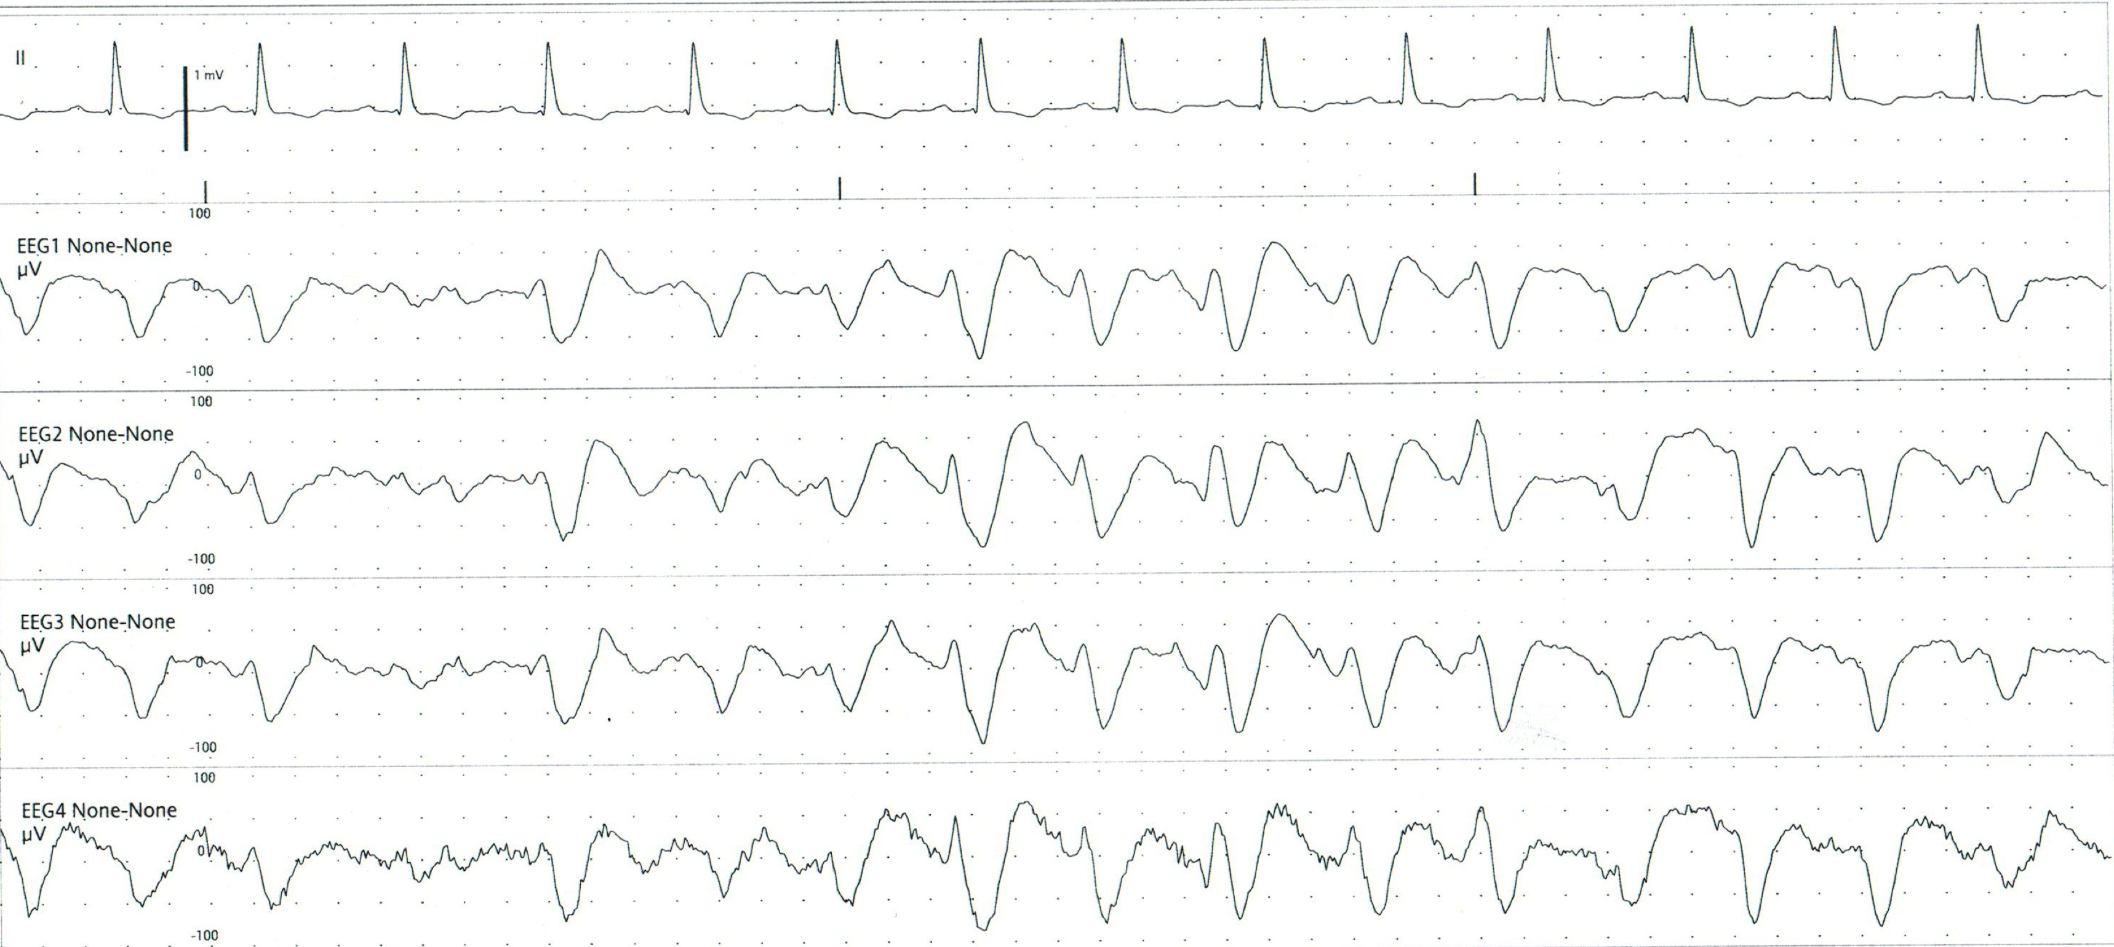
7
The following subhairline EEG shows:
Triphasic waves
A generalised seizure
Diffuse delta
Burst suppression

Slide 24
7
The following subhairline EEG shows:
Triphasic waves
A generalised seizure
Diffuse delta
Burst suppression

Slide 25
7
1
2
3
Triphasic waves have three main components: 1) a small negative component; 2) a large positive component; and 3) a last negative component returning to the baseline. They may appear as a single wave or as a cluster of triphasic waves.

Slide 26
7
Single triphasic wave
Cluster of triphasic waves

Slide 27
8
Choose the best answer:
Continuous subhairline EEG (using the 9 electrode set-up) is able to detect what percentage of seizures?
58%
68%
78%
88%

Slide 28
8
Choose the best answer:
Continuous subhairline EEG (using the 4-channel module) is able to detect what percentage of seizures?
58%
68%
78%
88%
The sensitivity of the bedside subhairline EEG module for seizures is 68%. The sensitivity of this system for epileptic spikes is only 39%. However, the specificity of the system for epileptic spikes or PLEDs is 92%.
Young et al. Neurocritical Care 2009; 11: 411-416.

Slide 29
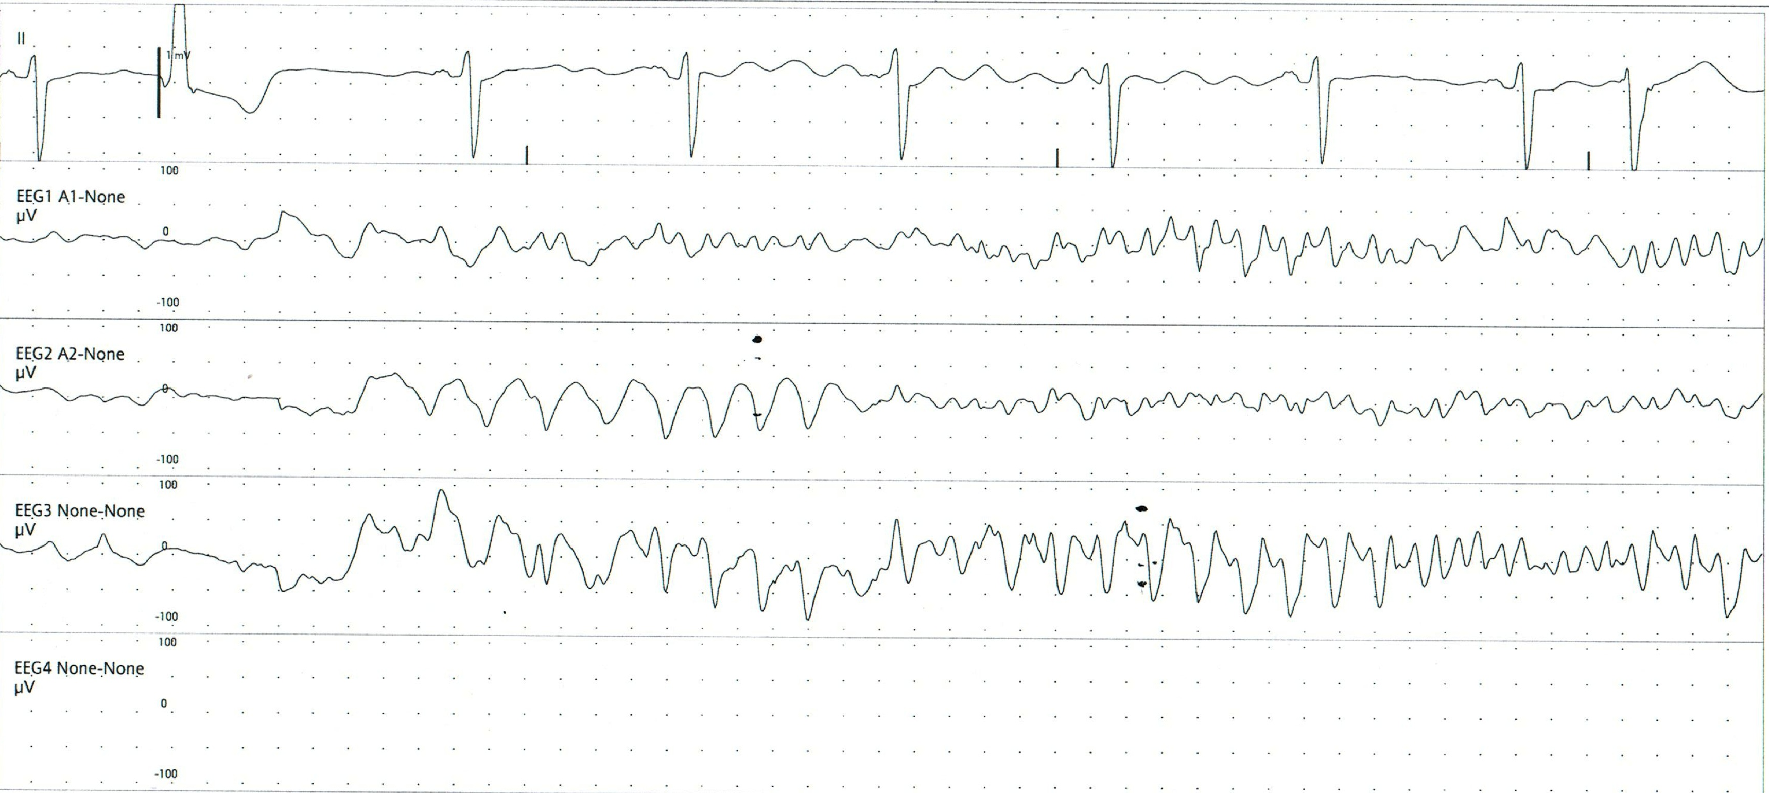
9
The following subhairline EEG demonstrates:
Diffuse delta
A generalised seizure
A cluster of triphasic waves
Chest physiotherapy artifact

Slide 30
9
The following subhairline EEG demonstrates:
Diffuse delta
A generalised seizure
A cluster of triphasic waves
Chest physiotherapy artifact
NB: the 4th channel is not recording.

Slide 31
9
The arrow shows the onset of the seizure. Note the evolution of the discharge over time: both the amplitude and the frequency of the activity is changing with respect to time. While the discharge is maximal in channel 3, it can be seen easily in channels 1 and 3 also.

Slide 32
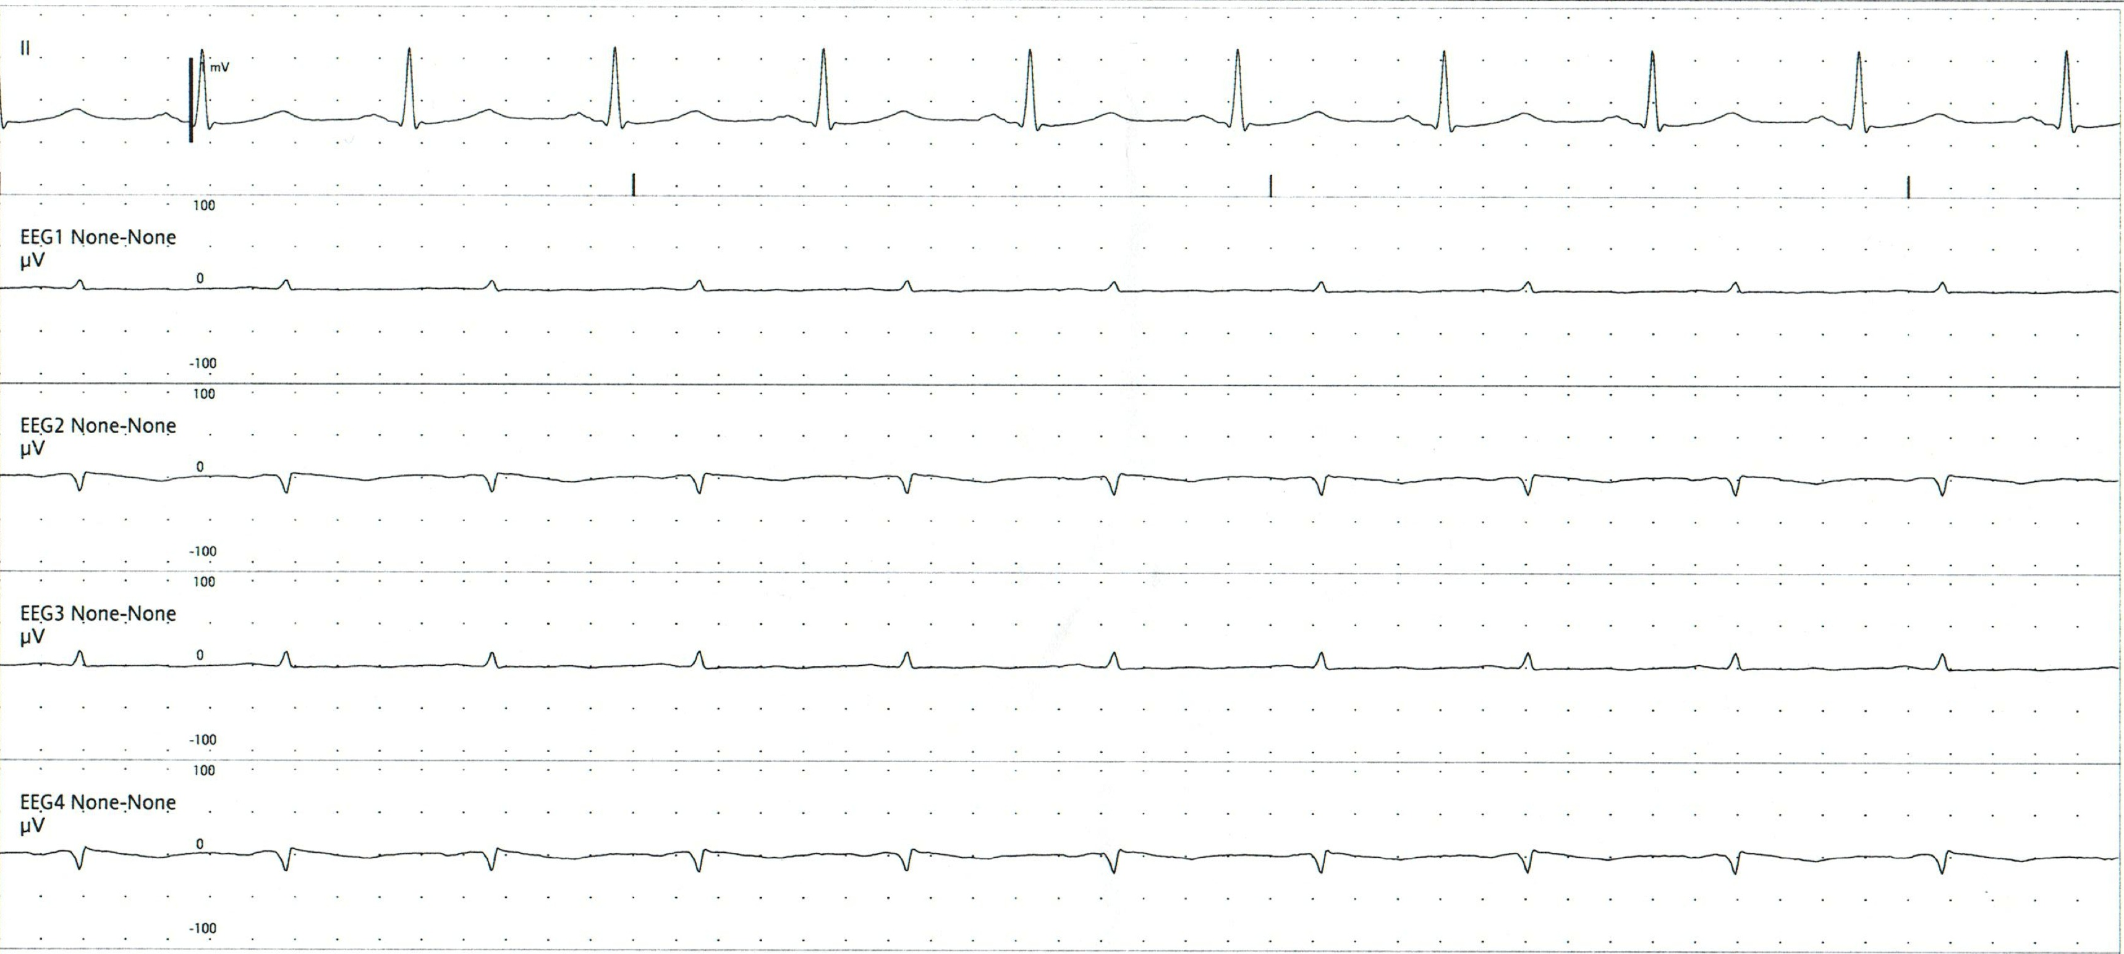
10
The following subhairline EEG represents:
Severe suppression with artifact
The EEG leads are not properly plugged in
Burst-suppression

Slide 33
10
The following subhairline EEG represents:
Severe suppression with artifact
The EEG leads are not properly plugged in
Burst-suppression

Slide 34
10
There is no discernable cerebral activity in this subhairliner EEG. This is not synonymous with brain death since the recording is not compliant with the requirements for recording electrocerebral inactivity.
The EKG artifact is seen prominently since cerebral activity is so severely depressed.

Slide 35
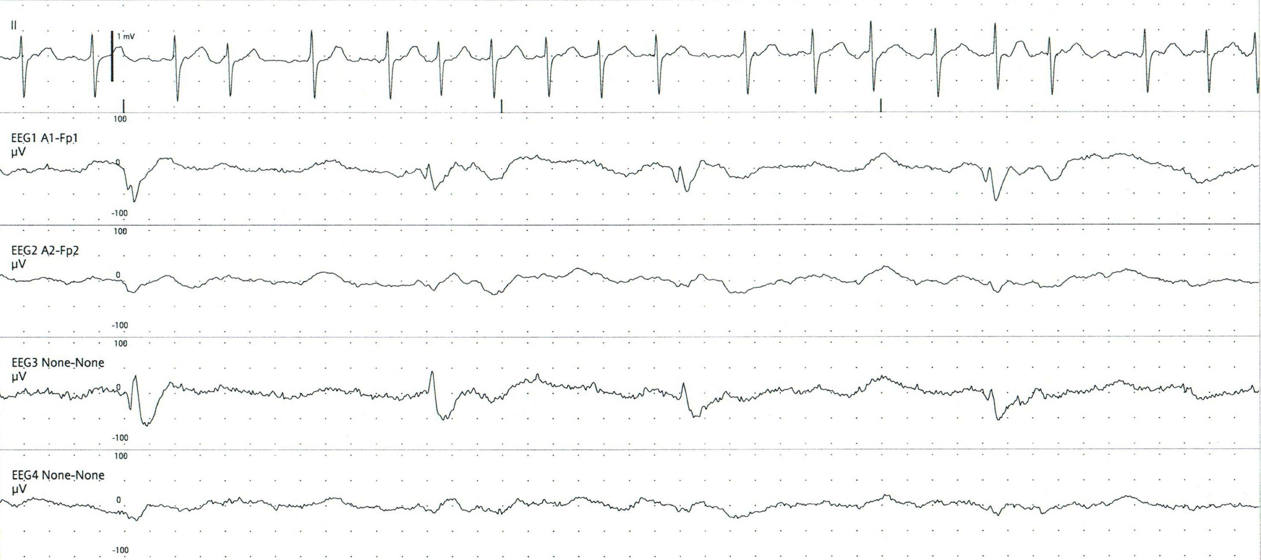
11
The following subhairline EEG shows:
Generalised epileptiform spikes
Periodic lateralised epileptiform discharges
Burst-suppression
Delta with movement artifacg

Slide 36
11
The following subhairline EEG shows:
Generalised epileptiform spikes
Periodic lateralised epileptiform discharges
Burst-suppression
Delta with movement artifact

Slide 37
11
The arrows show the periodic lateralised (one hemisphere only) epileptiform discharges (PLEDs). Note that the discharges are seen only in the left hemispheric channels.
This recording is from a patient with herpes simplex encephalitis.

Slide 38
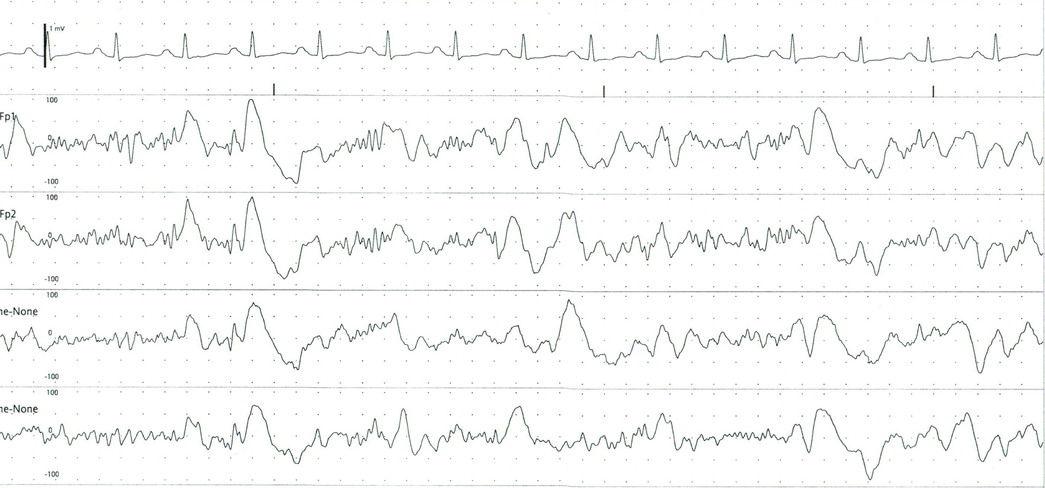
12
The following subhairline EEG shows:
Generalised epileptiform spikes
Mixed frequencies, all of cerebral origin
A generalised seizure
Delta with movement artifact

Slide 39
12
The following subhairline EEG shows:
Generalised epileptiform spikes
Mixed frequencies, all of cerebral origin
A generalised seizure
Delta with movement artifact

Slide 40
12
theta
alpha
beta
delta
There are multiple different frequencies of waveforms seen here. None can be called a spike-and-wave complex since the small ‘spike’ appearing after the delta is more likely to have occurred due to a combination of preceding waveforms rather than as an epileptic phenomenon.

Slide 41
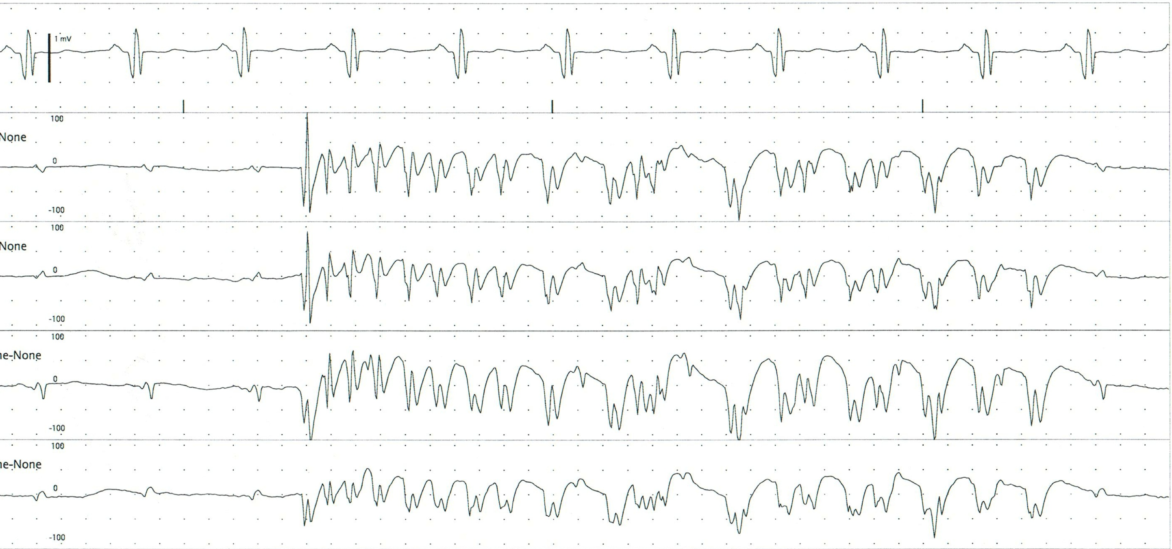
13
The following subhairline EEG shows:
Generalised epileptiform spikes
Movement artifact from myoclonus
A generalised seizure
Burst-suppression

Slide 42
13
The following subhairline EEG shows:
Generalised epileptiform spikes
Movement artifact from myoclonus
A generalised seizure
Burst-suppression

Slide 43
13
This is a very short seizure. There is a definite onset, an evolution over time (change in both amplitude and frequency of the waveforms) and a definite offset. The period of activity is longer than what is usually associated with burst-suppression and the bursts within a burst-suppression pattern do not show evolution.

Slide 44
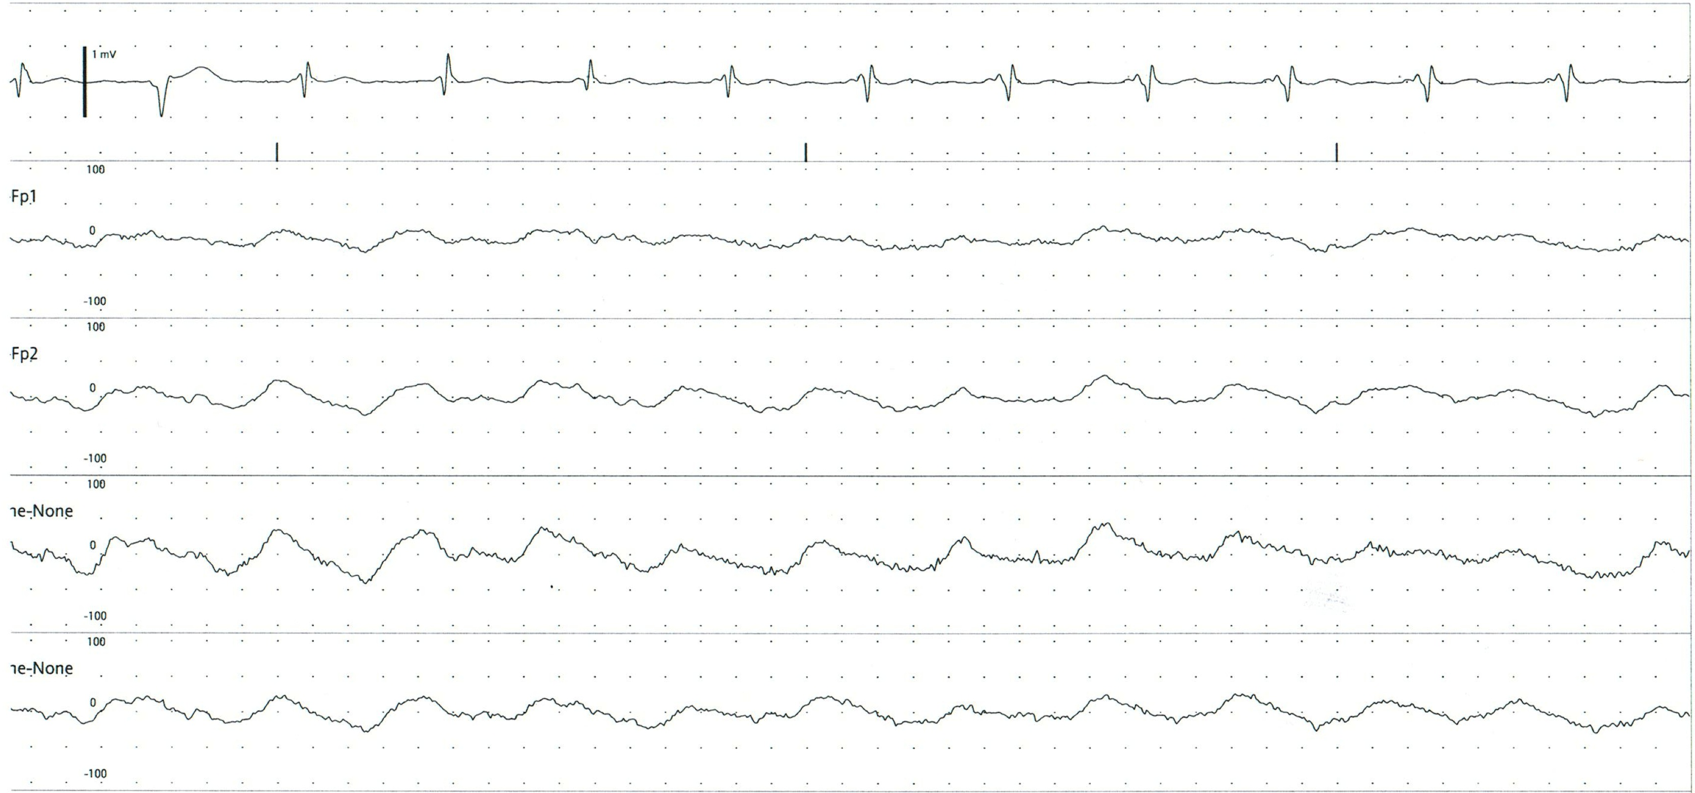
14
The following subhairline EEG shows:
Diffuse low voltage delta
Pulse artifact within an otherwise suppressed EEG
Triphasic waves
suppression

Slide 45
14
The following subhairline EEG shows:
Diffuse low voltage delta
Pulse artifact within an otherwise suppressed EEG
Triphasic waves
suppression

Slide 46
14
There is prominent cardioballistic (pulse) artifact seen in this EEG. It is prominent because cerebral activity is so suppressed.

Slide 47
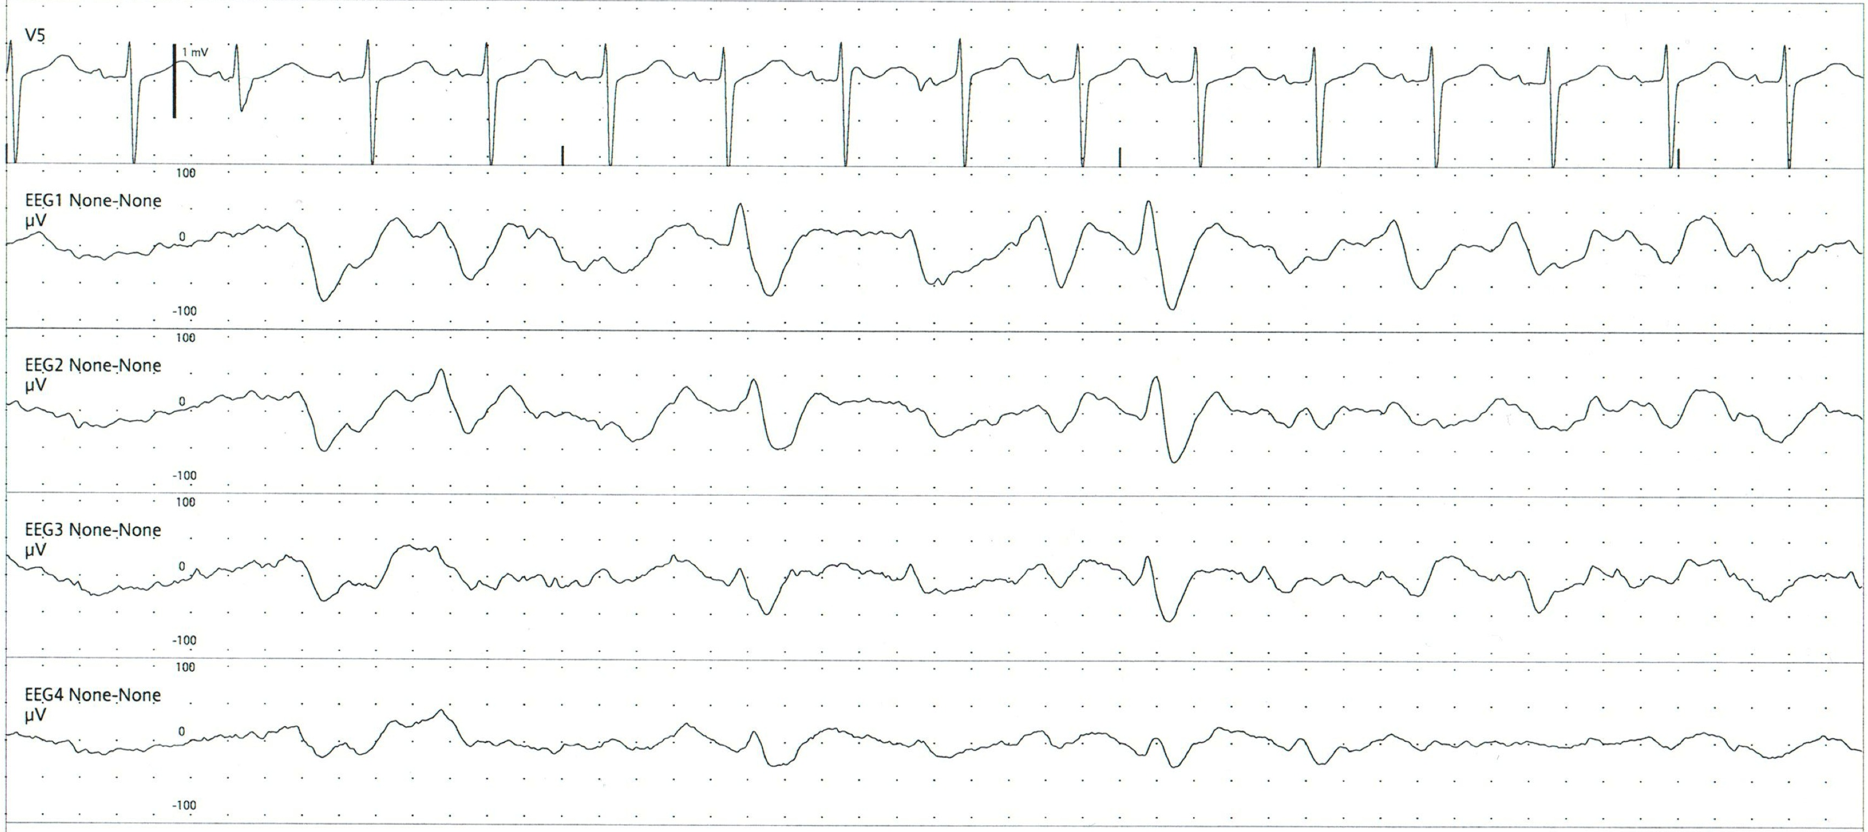
15
This subhairline EEG demonstrates:
Generalised periodic epileptiform discharges
Diffuse detla
Triphasic waves
A generalised seizure

Slide 48
15
This subhairline EEG demonstrates:
Generalised periodic epileptiform discharges
Diffuse detla
Triphasic waves
A generalised seizure

Slide 49
15
It is very difficult to determine whether or not these generalised discharges are triphasic waves or generalised periodic epileptiform discharges. The patient’s history and clinical data in as well as a formal EEG will assist in differentiating these waveforms.

Slide 50
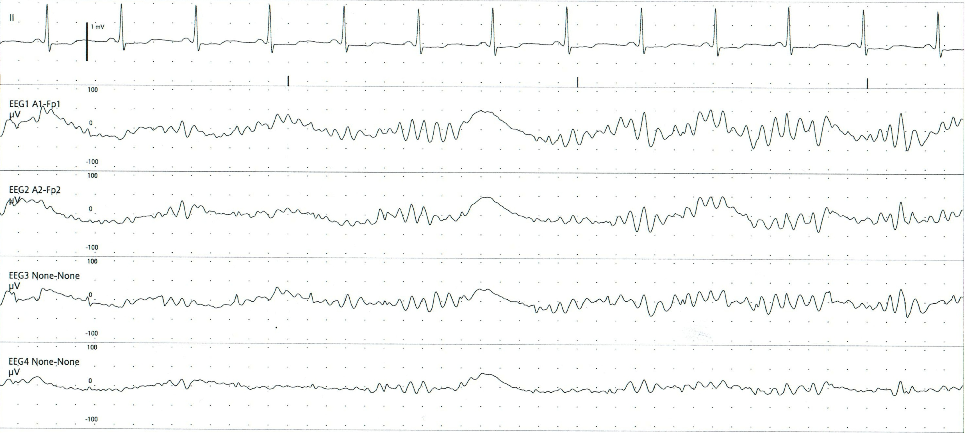
16
The following subhairline EEG shows:
Normal sleep spindles
A generalised seizure
Intermittent delta waves
Theta coma pattern

Slide 51
16
The following subhairline EEG shows:
Normal sleep spindles
A generalised seizure
Intermittent delta waves
Theta coma pattern

Slide 52
16
Sleep spindle
Rarely, patients in the ICU demonstrate normal sleep patterns. This EEG shows normal sleep spindles with occasional delta waves. This is typical of stage 2 (N2) sleep.

