Slide 1
Subhairline EEG Part III – Seizures and Spikes
Teneille Gofton
September 2013

Slide 2
Objectives
To discuss lateralised periodic discharges
To review generalised periodic discharges
To show examples of focal and generalised seizures

Slide 3
Subhairline EEG
Young et al 2009
Continuous subhariline EEG monitoring detects 70% of non-convulsive seizures when compared to formal EEG
But, 98% specificity when seizures are seen
The lower sensitivity for seizures is because only the anterior frontal and temporal lobes are covered by the subhairline electrodes

Slide 4
Epileptiform Abnormalities
Generally include:
Spikes
Seizures
These may be focal, multifocal, lateralised or generalised

Slide 5
Spikes
Brief, sharply contoured discharges
aftercoming slow wave
May be focal, multifocal or generalised

Slide 6
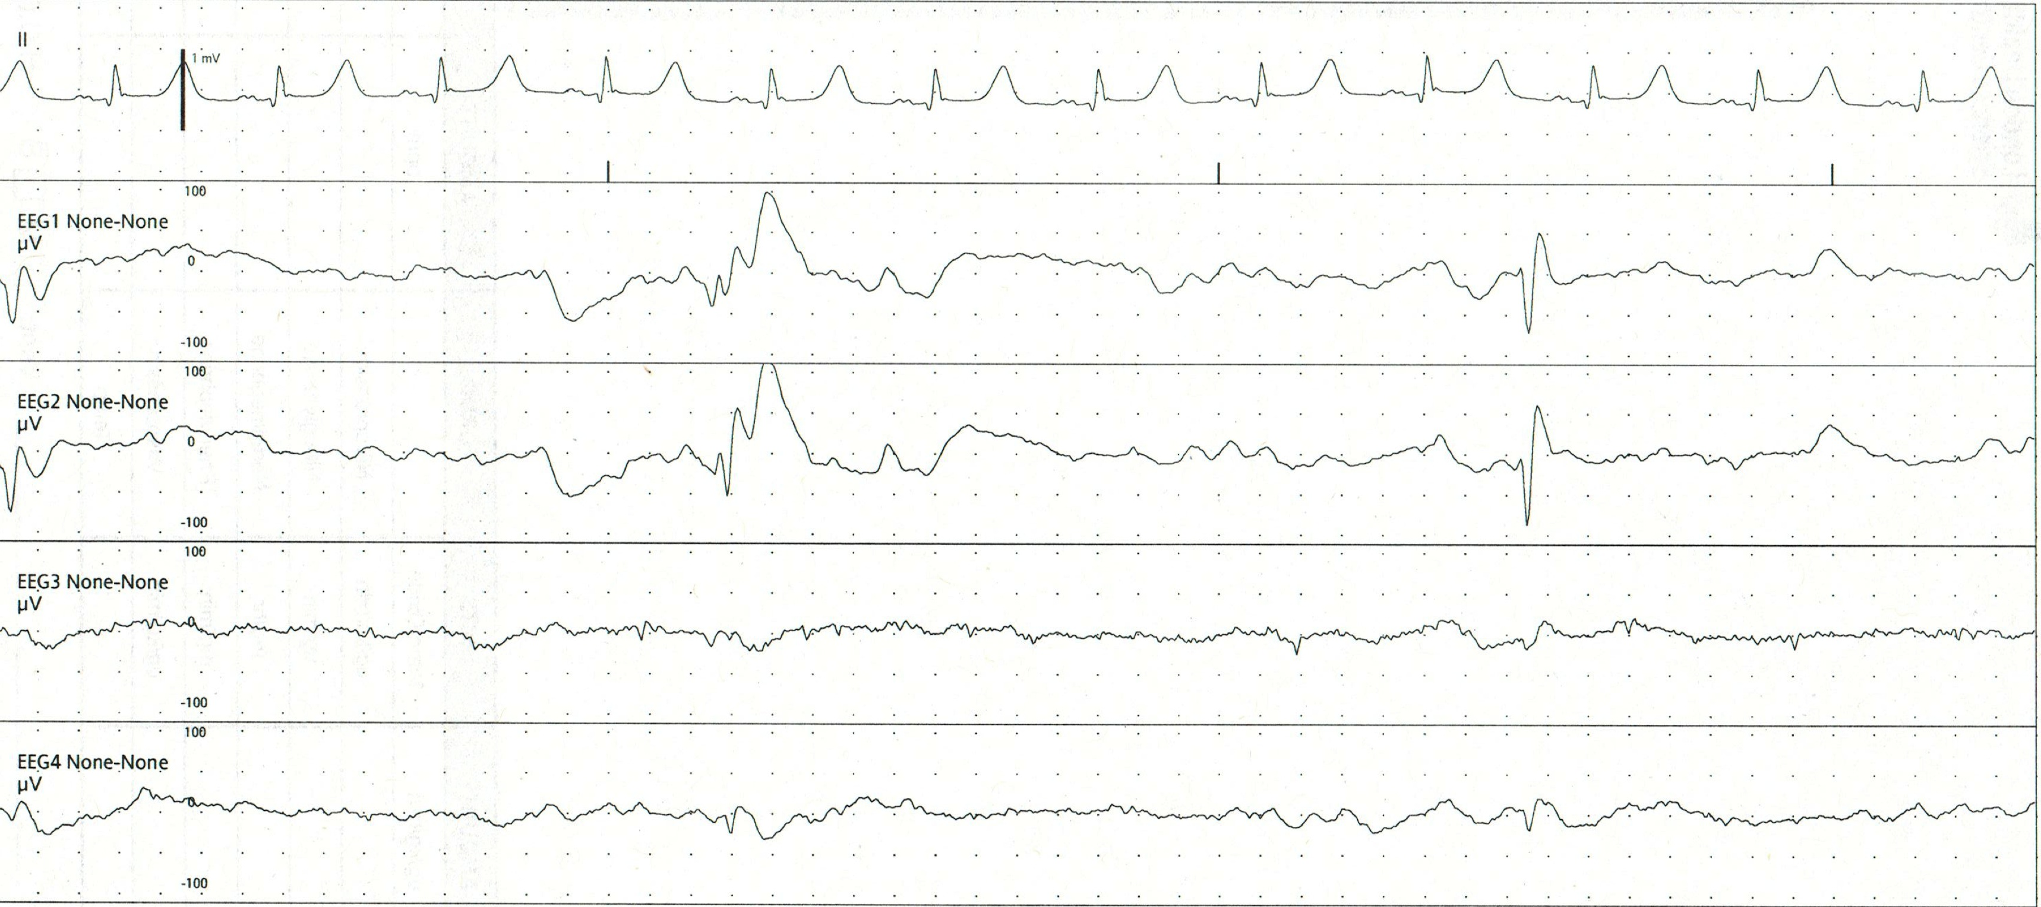
Spikes
Polyspike and wave
Spike and wave

Slide 7
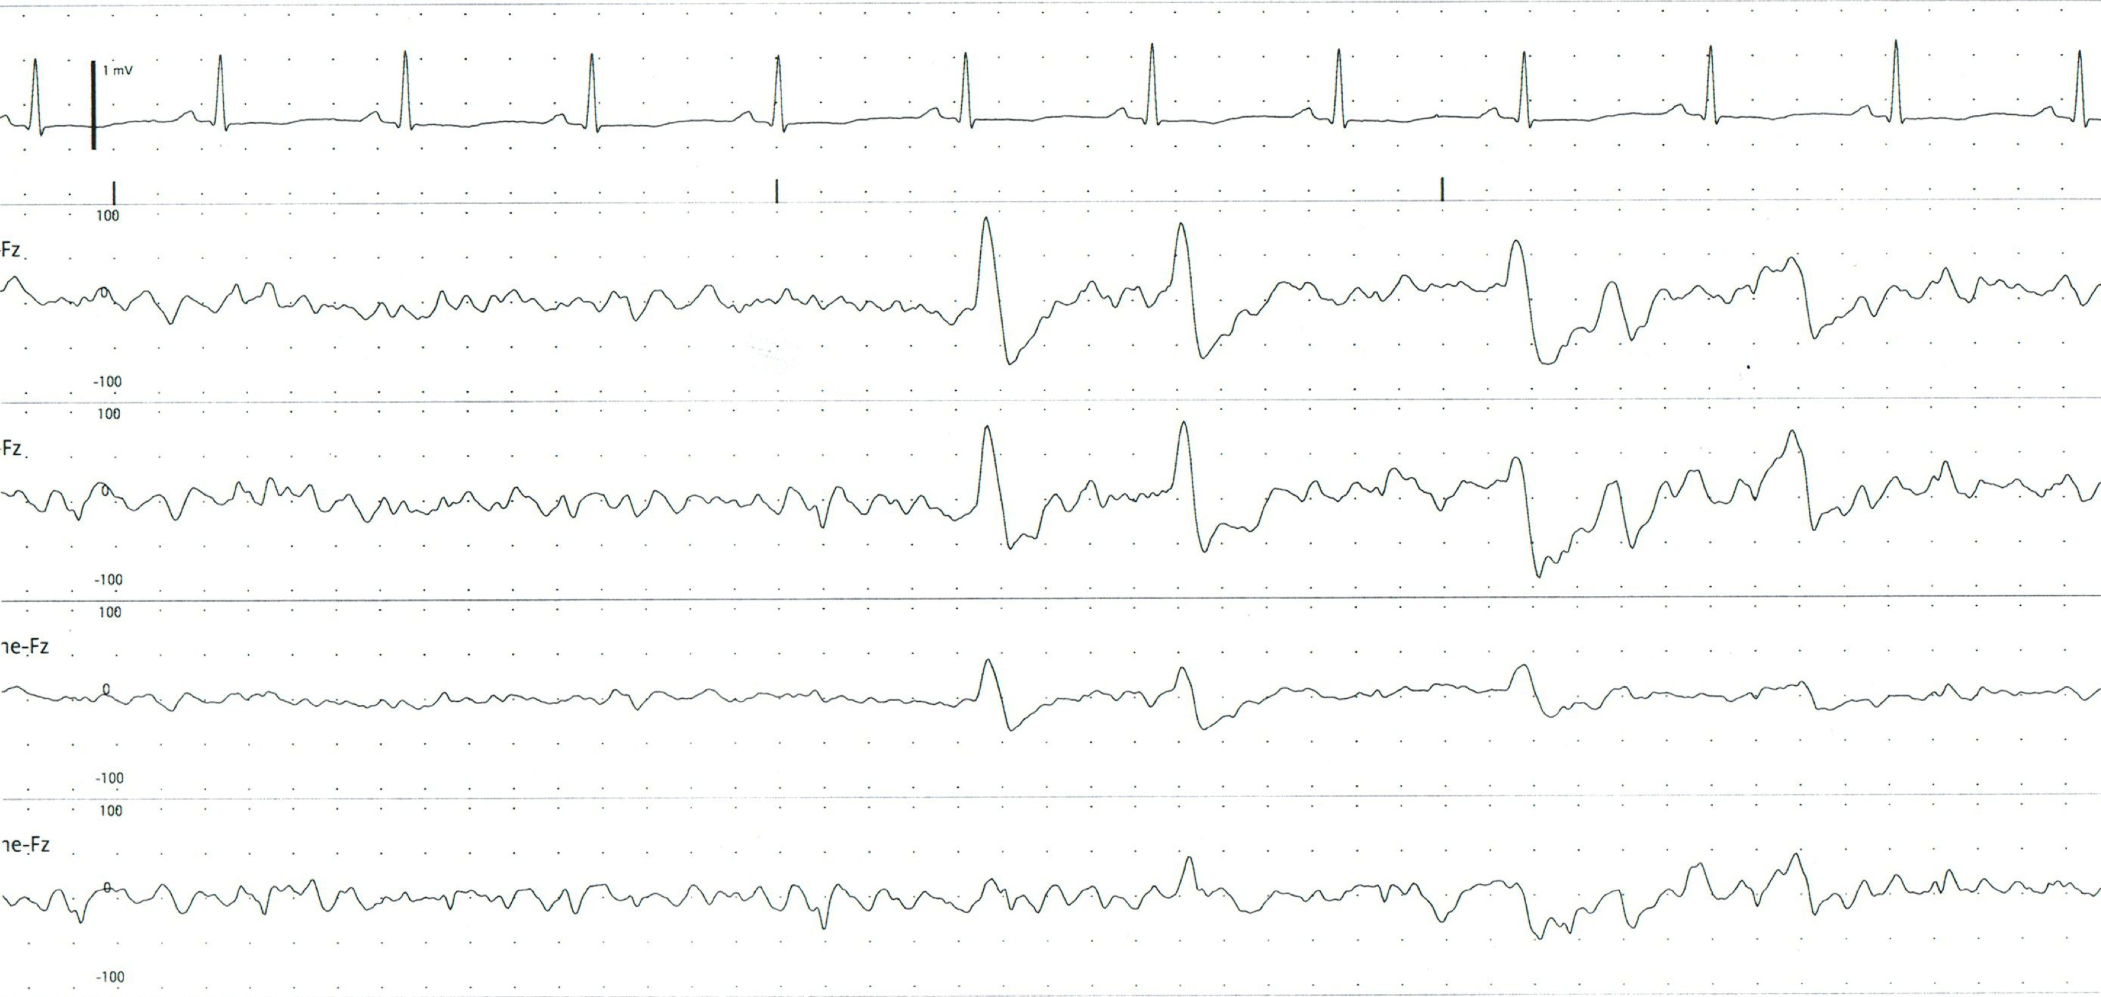
Bifrontal Spikes

Slide 8
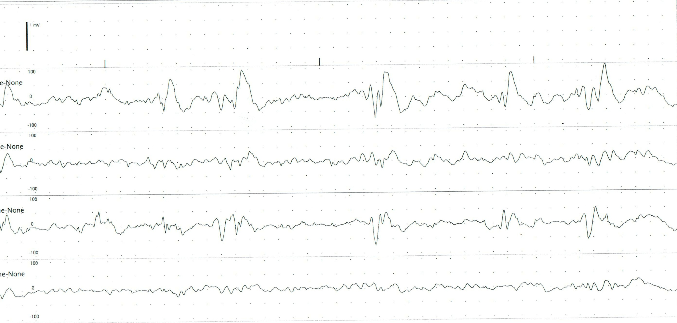
Left Polyspikes

Slide 9
Lateralised Periodic Discharges (LPDs)
Also known as periodic lateralised epileptiform discharges (PLEDs)
Occur unilaterally
Occur periodically – with regular frequency
Usually from 0.5 – 3 Hz
Stereotyped – look the same each time
Morphology – sharp waves or sharp wave complexes

Slide 10
Lateralised Periodic Discharges (LPDs)
Generally associated with an acute, focal, destructive neurological process
e.g. acute stroke (most common cause)
e.g. herpes simplex encephalitis
Usually transient
Lasting hours to weeks
Most patients with LPDs do not have a history of epilepsy

Slide 11
Lateralised Periodic Discharges (LPDs)
LPDs can be confused with EKG artifact, especially if left sided
Due to proximity to the heart, EKG artifact is most likely to be seen in channel 3 (left temporal)

Slide 12
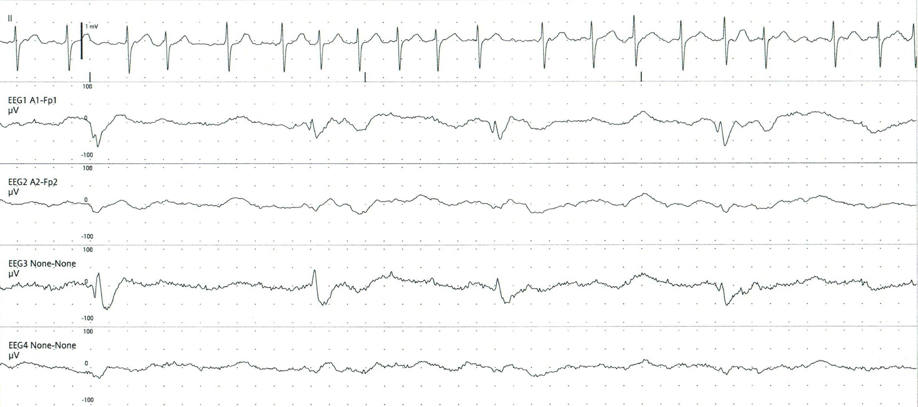
Left LPDs

Slide 13
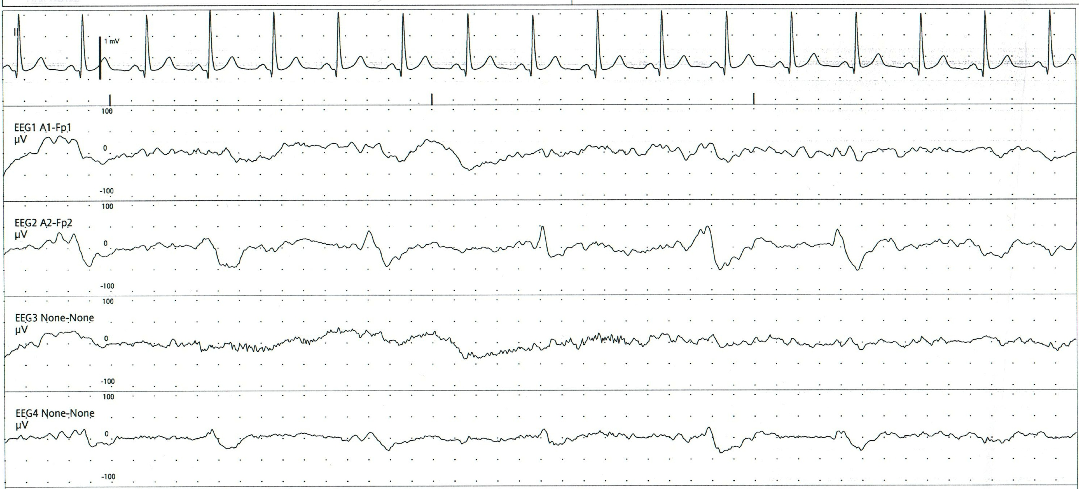
Right LPDs

Slide 14
LPDs and Seizures
Many patients with LPDs also have seizures
Usually focal motor seizures

Slide 15
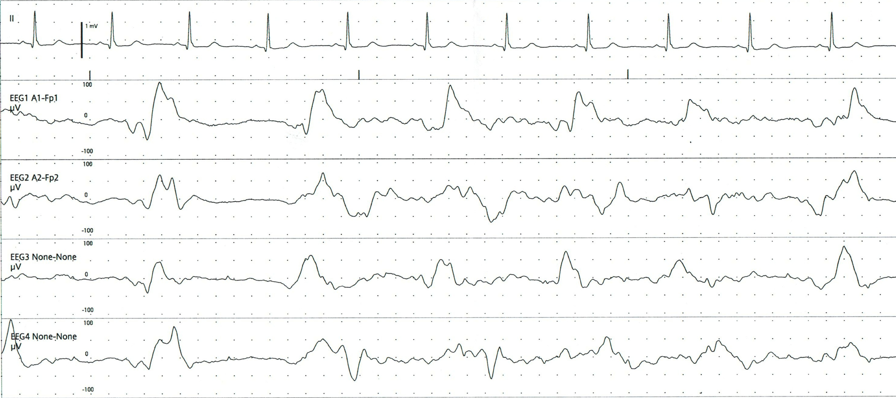
Bilateral LPDs (BiPLEDs)

Slide 16
Generalised Periodic Discharges (GPDs)
Most frequently seen in critical care setting
Similar to LPDs, but seen throughout the brain
Represent severe cerebral dysfunction
May be a type of seizure, but it is uncertain if aggressive treatment alters outcome

Slide 17
Generalised Periodic Discharges (GPDs)
Often a result of
Hypoxic-ischemic encephalopathy
Neurodegenerative disease
Terminal stages of generalised status epilepticus
High degree of mortality associated with GPDs

Slide 18
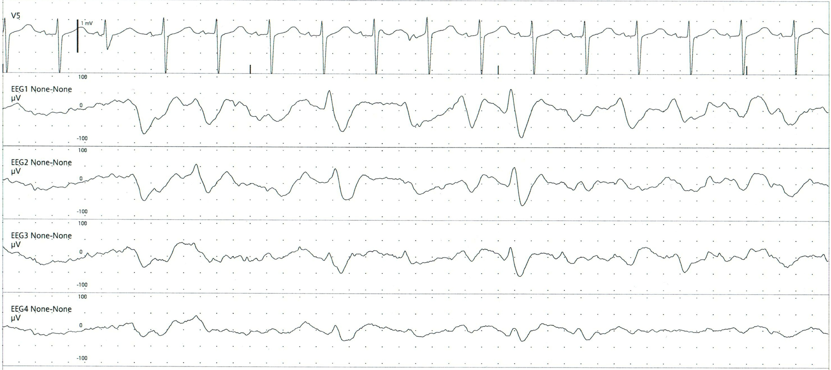
GPDs

Slide 19
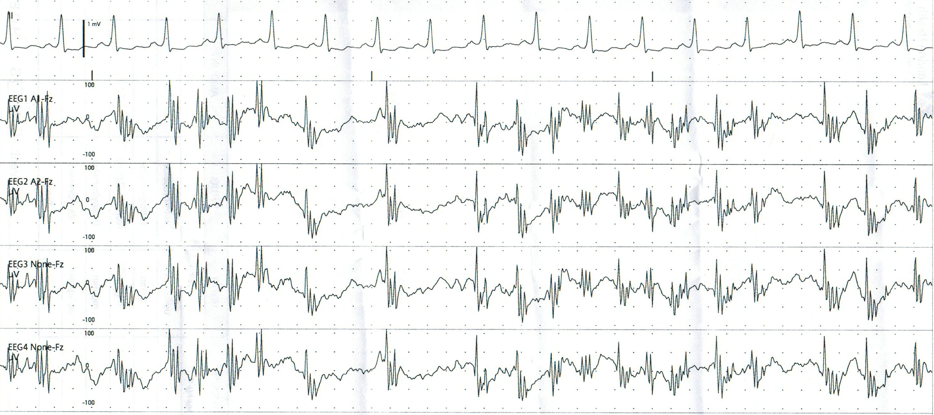
GPDs

Slide 20
Generalised Seizure
Involves both hemispheres from the onset
Evolution of frequency and voltage over time
Postictal suppression or delta is common

Slide 21
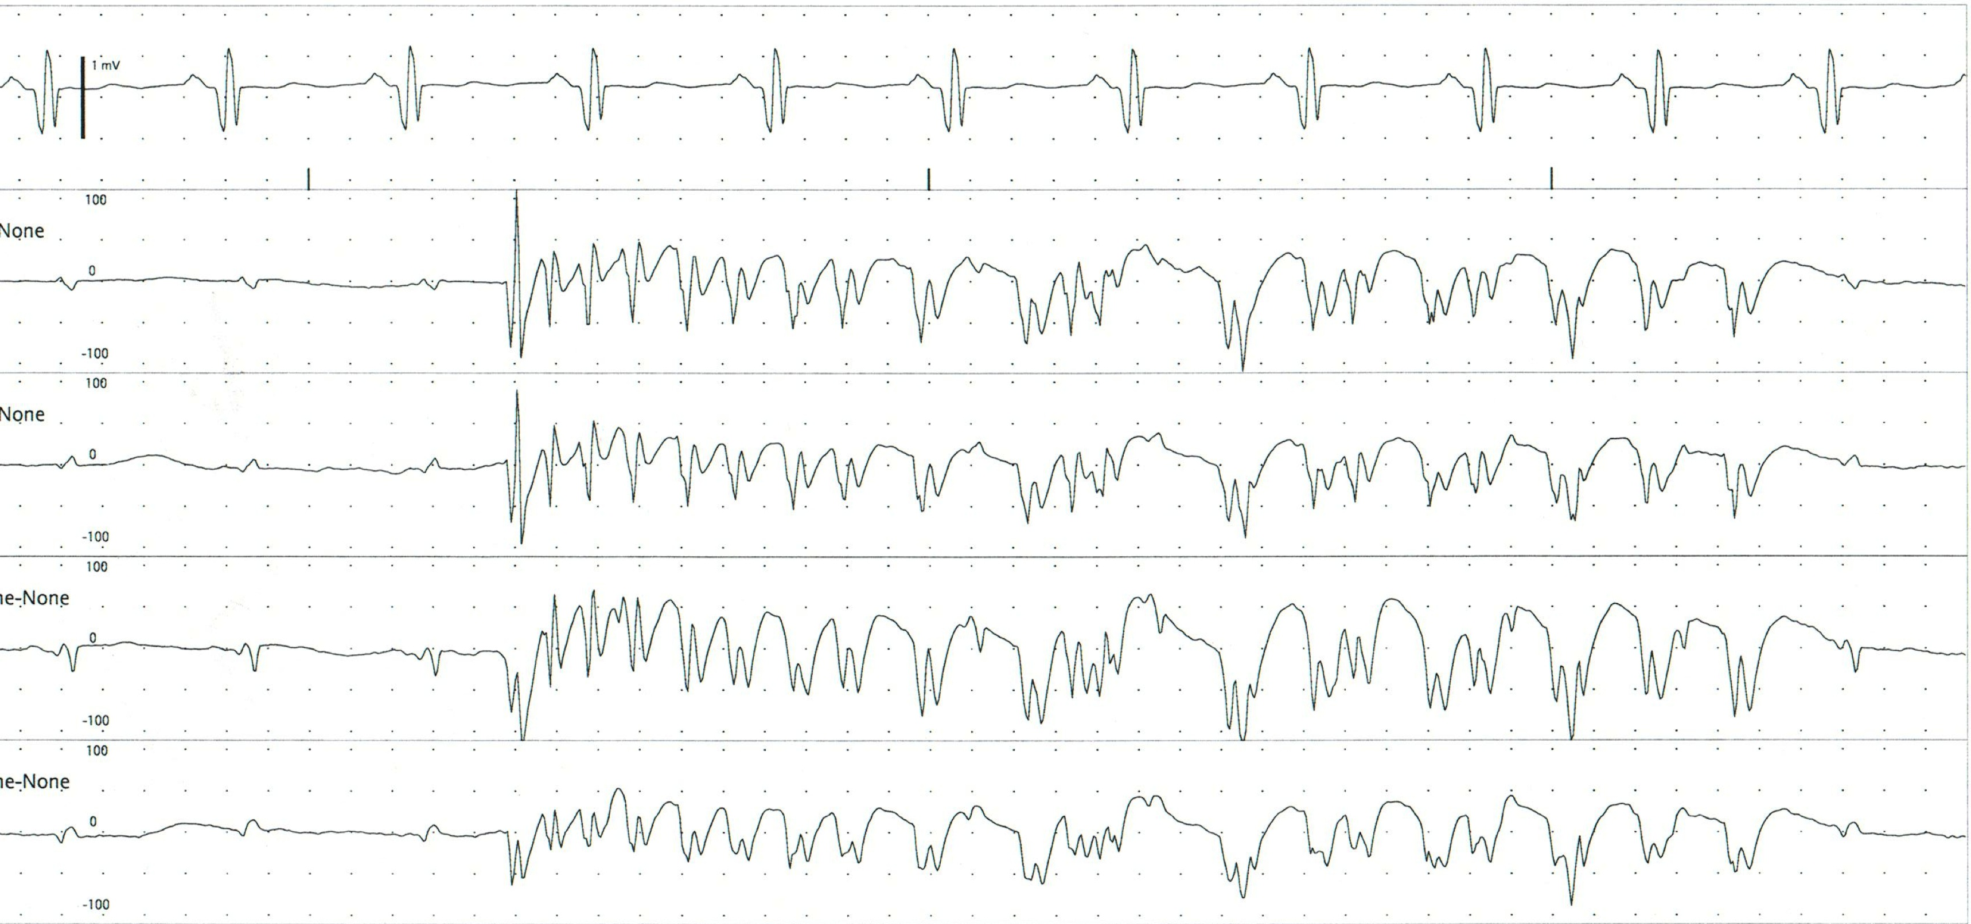
Larval Seizure (<10 sec)

Slide 22
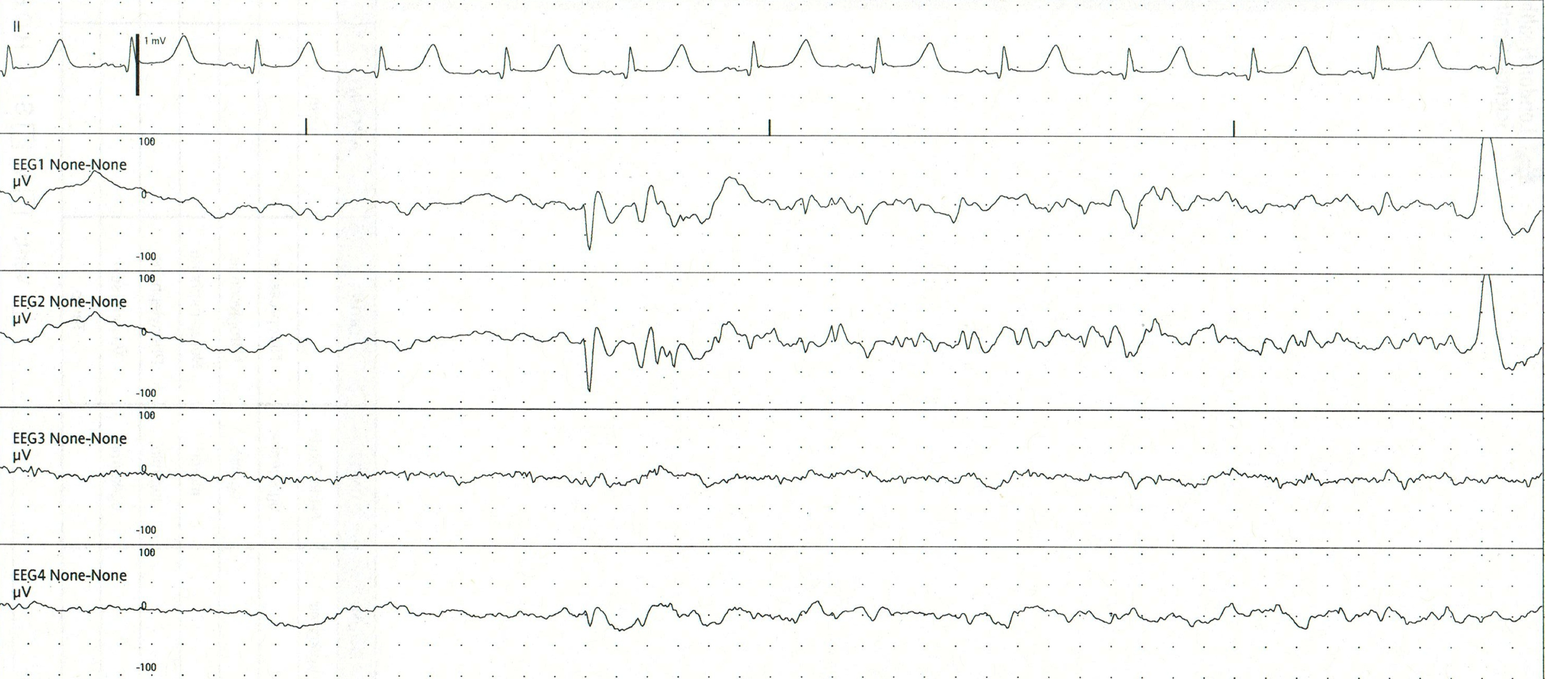
Generalised Convulsive Seizure

Slide 23
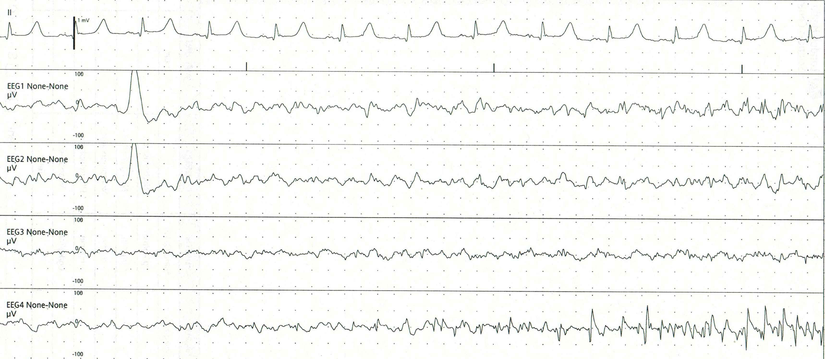
Generalised Convulsive Seizure

Slide 24
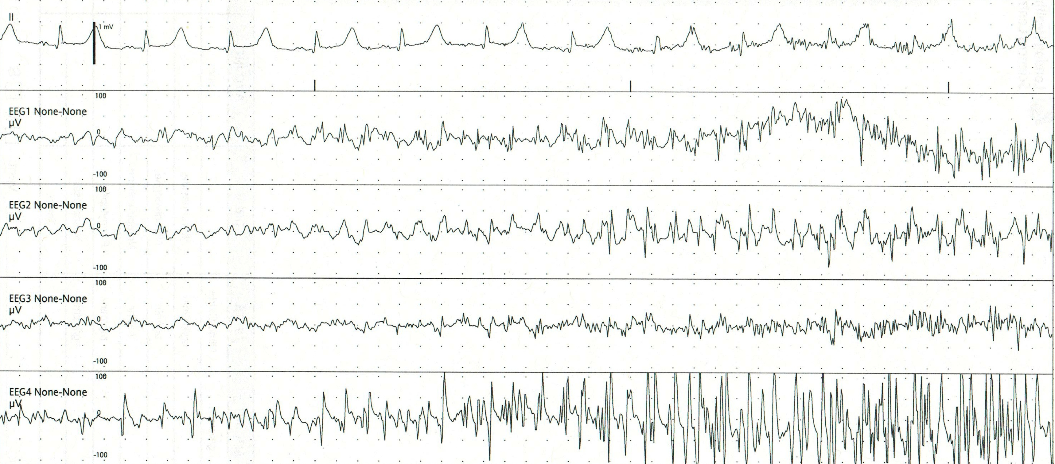
Generalised Convulsive Seizure

Slide 25
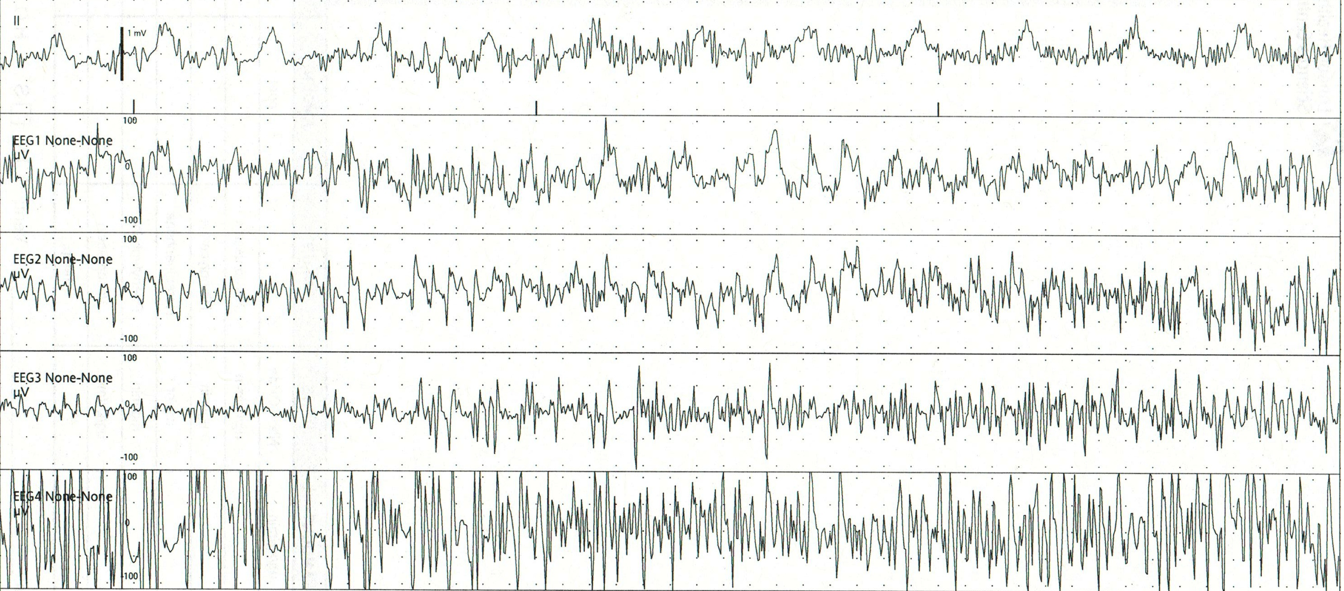
Generalised Convulsive Seizure

Slide 26
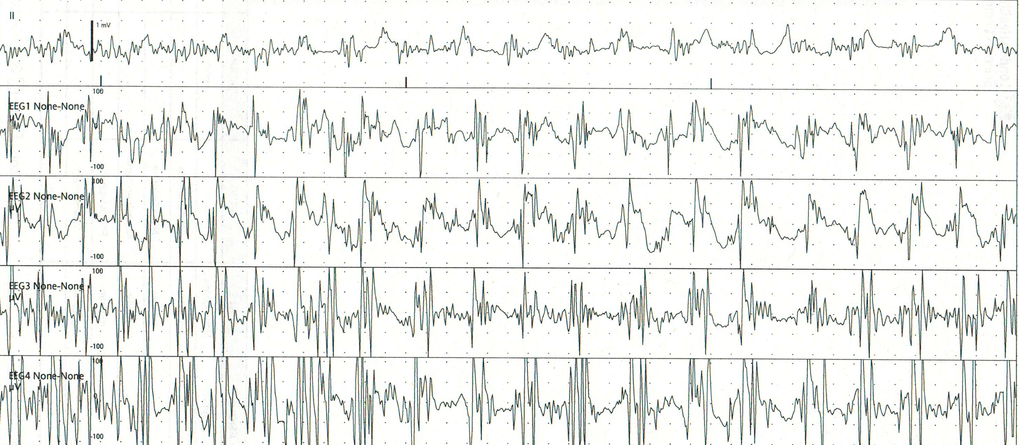
Generalised Convulsive Seizure

Slide 27
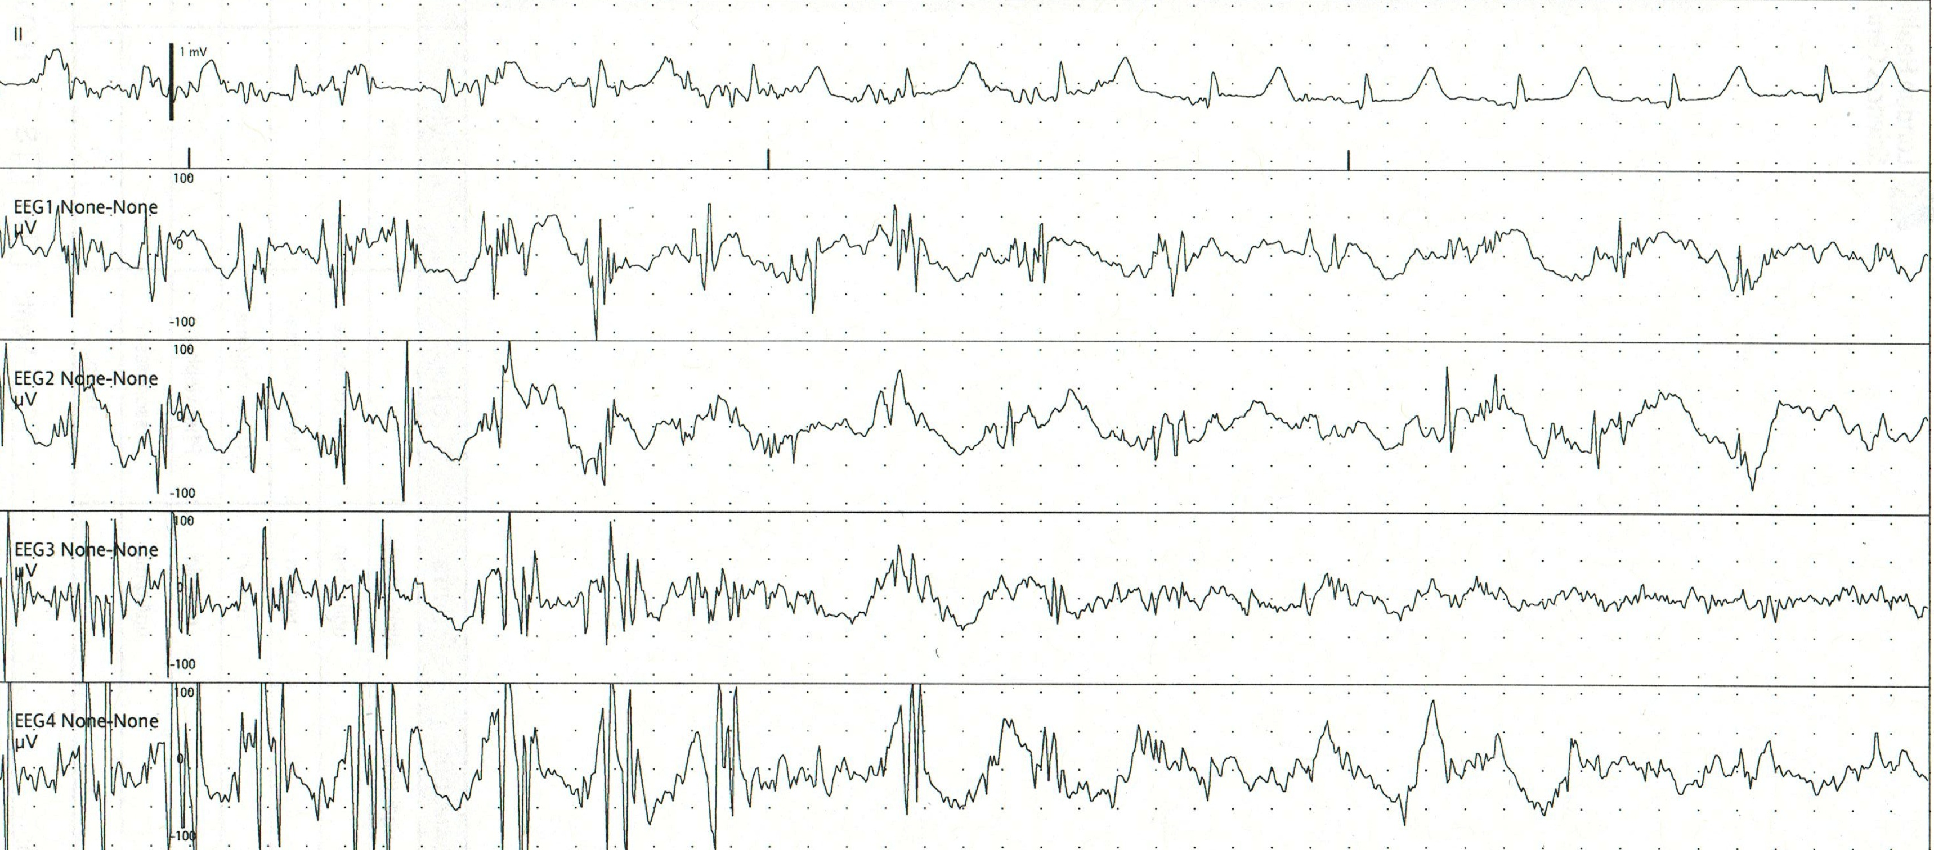
Generalised Convulsive Seizure

Slide 28
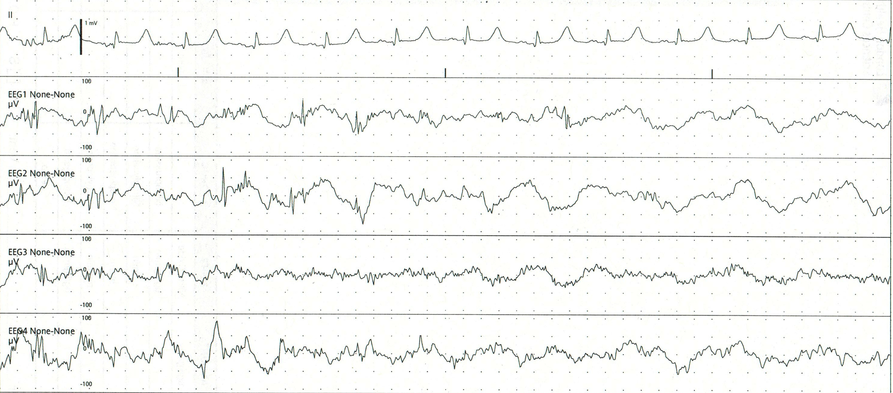
Generalised Convulsive Seizure

Slide 29
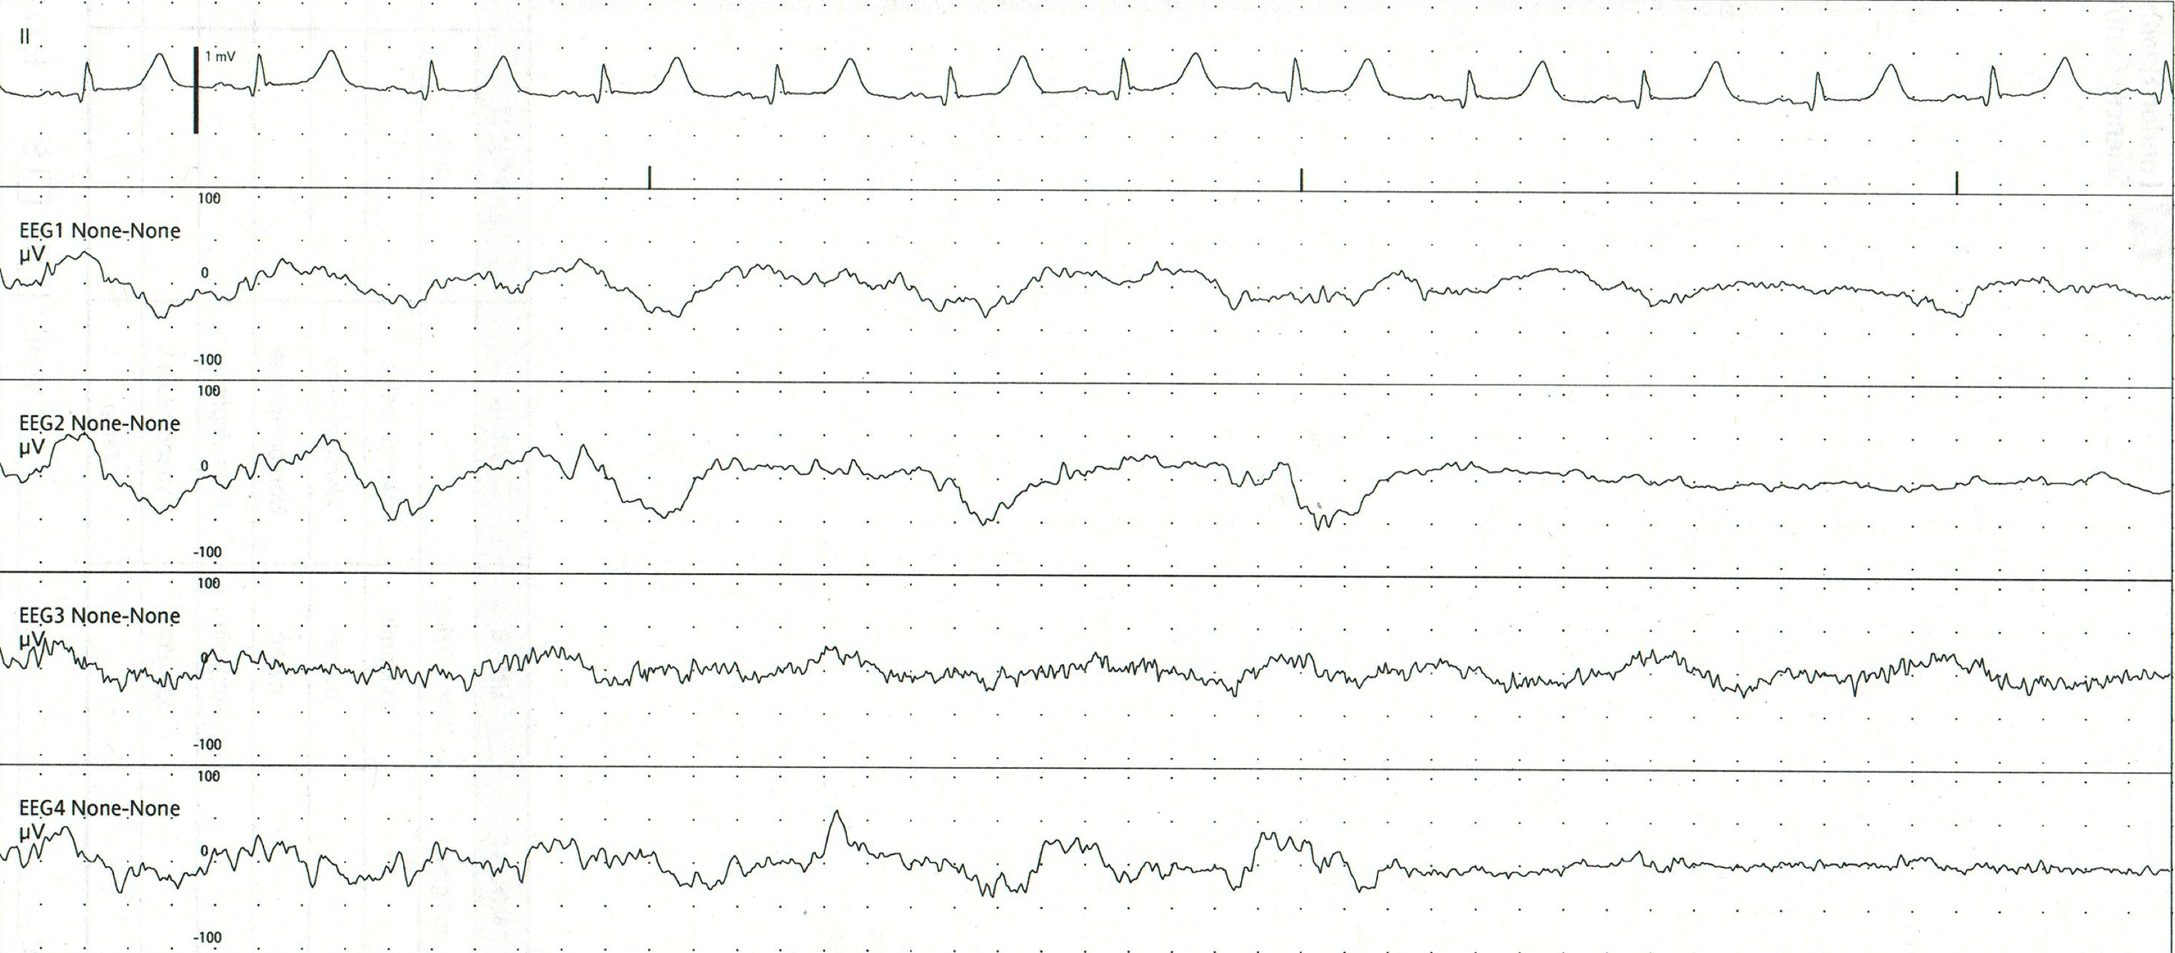
Generalised Convulsive Seizure

Slide 30
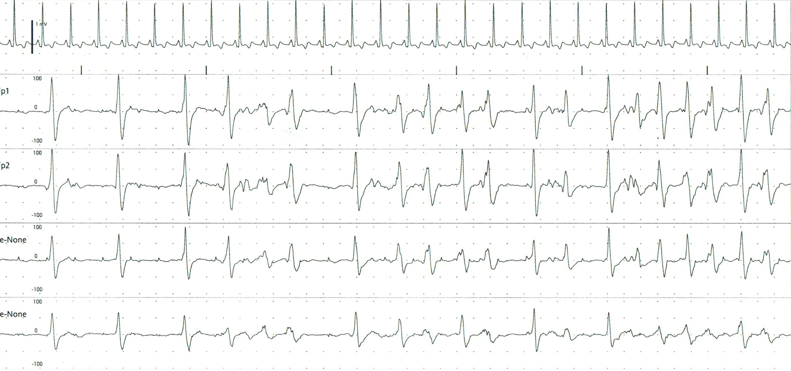
Generalised Non-convulsive Seizure

Slide 31
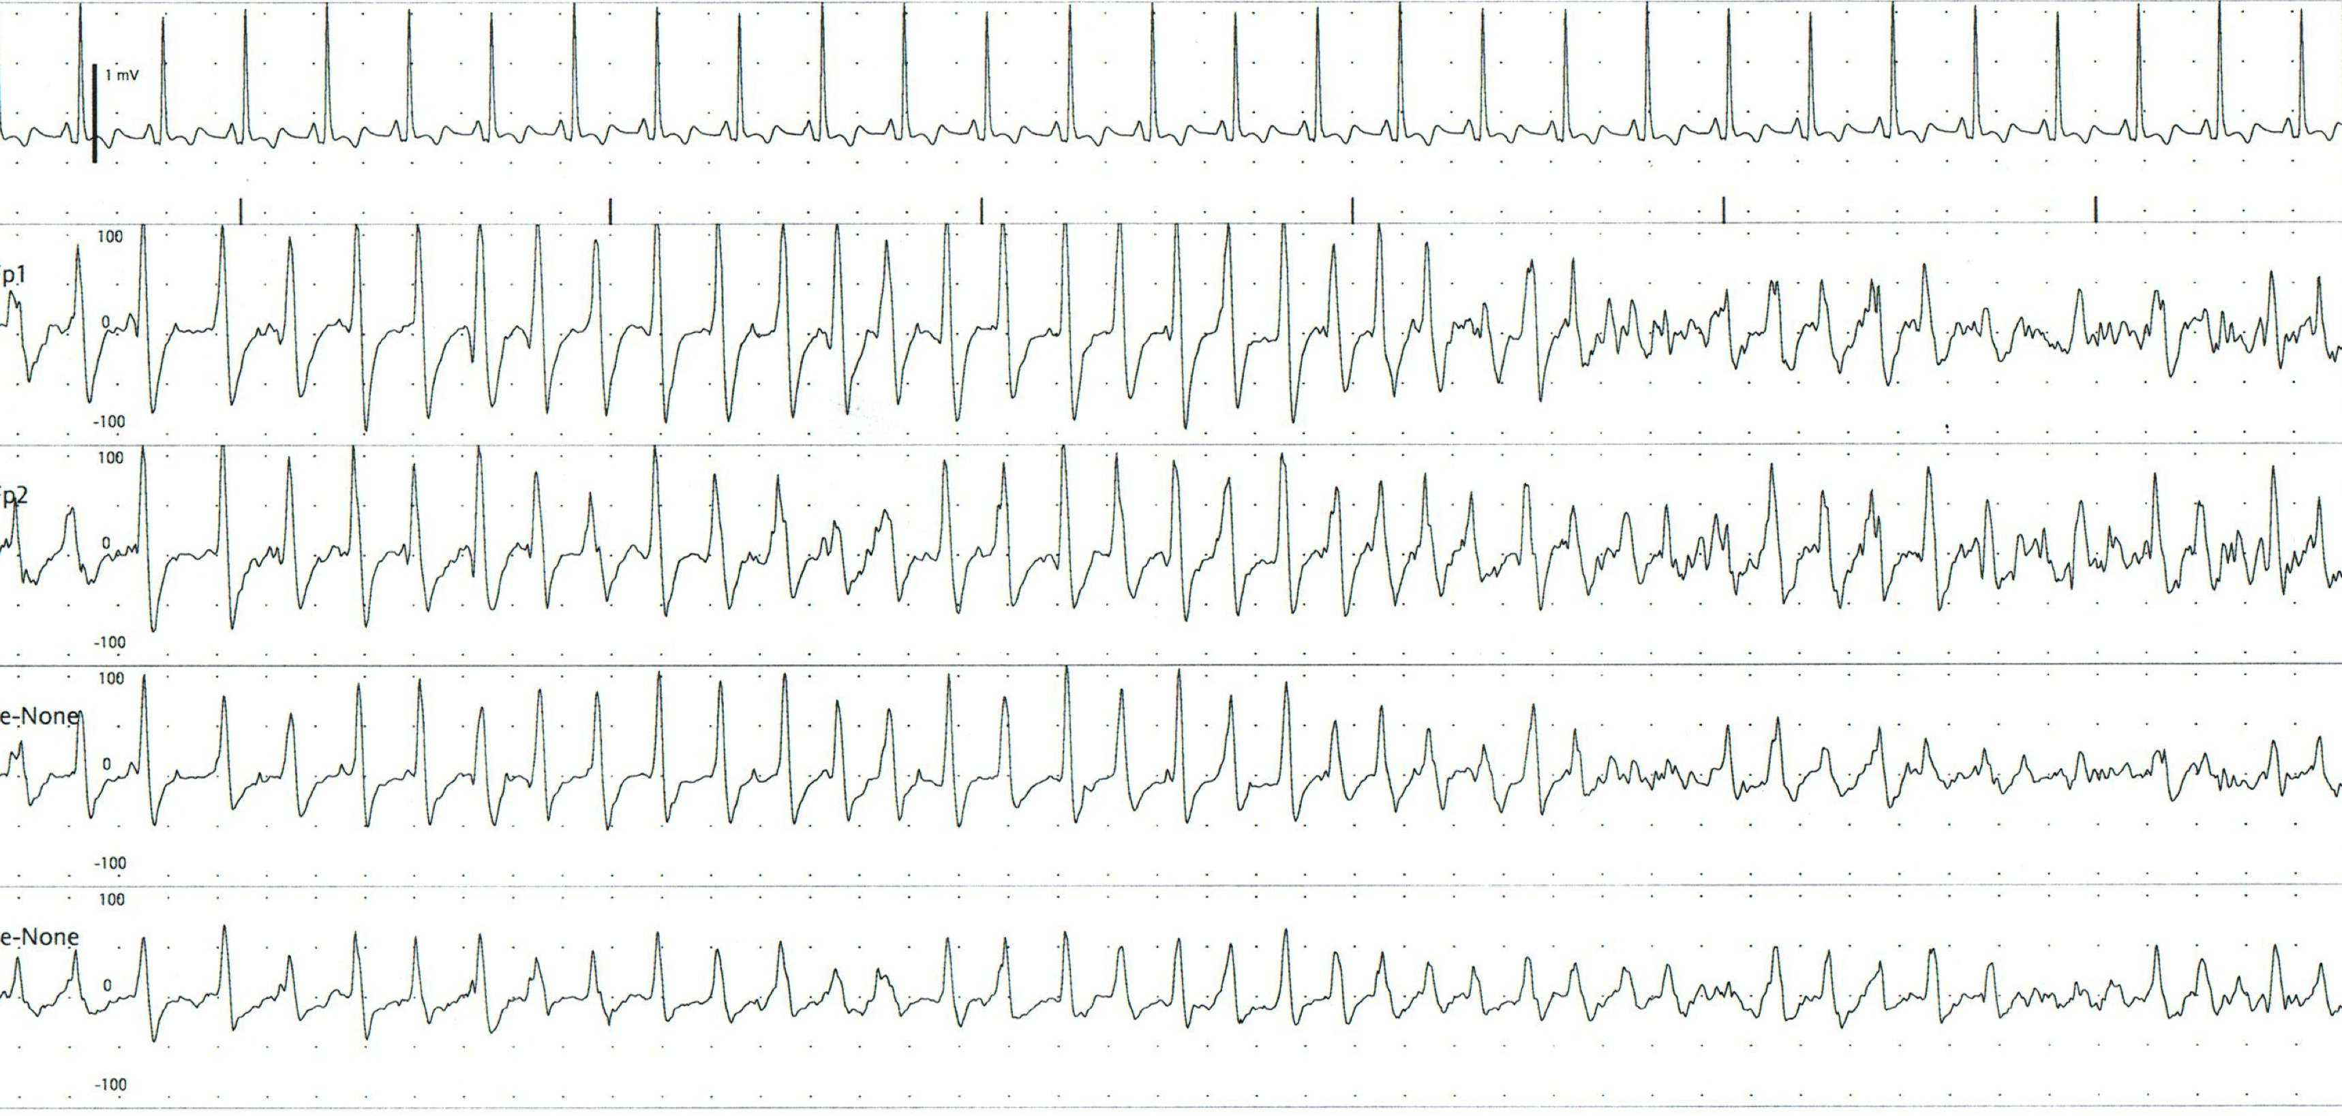
Generalised Non-convulsive Seizure

Slide 32
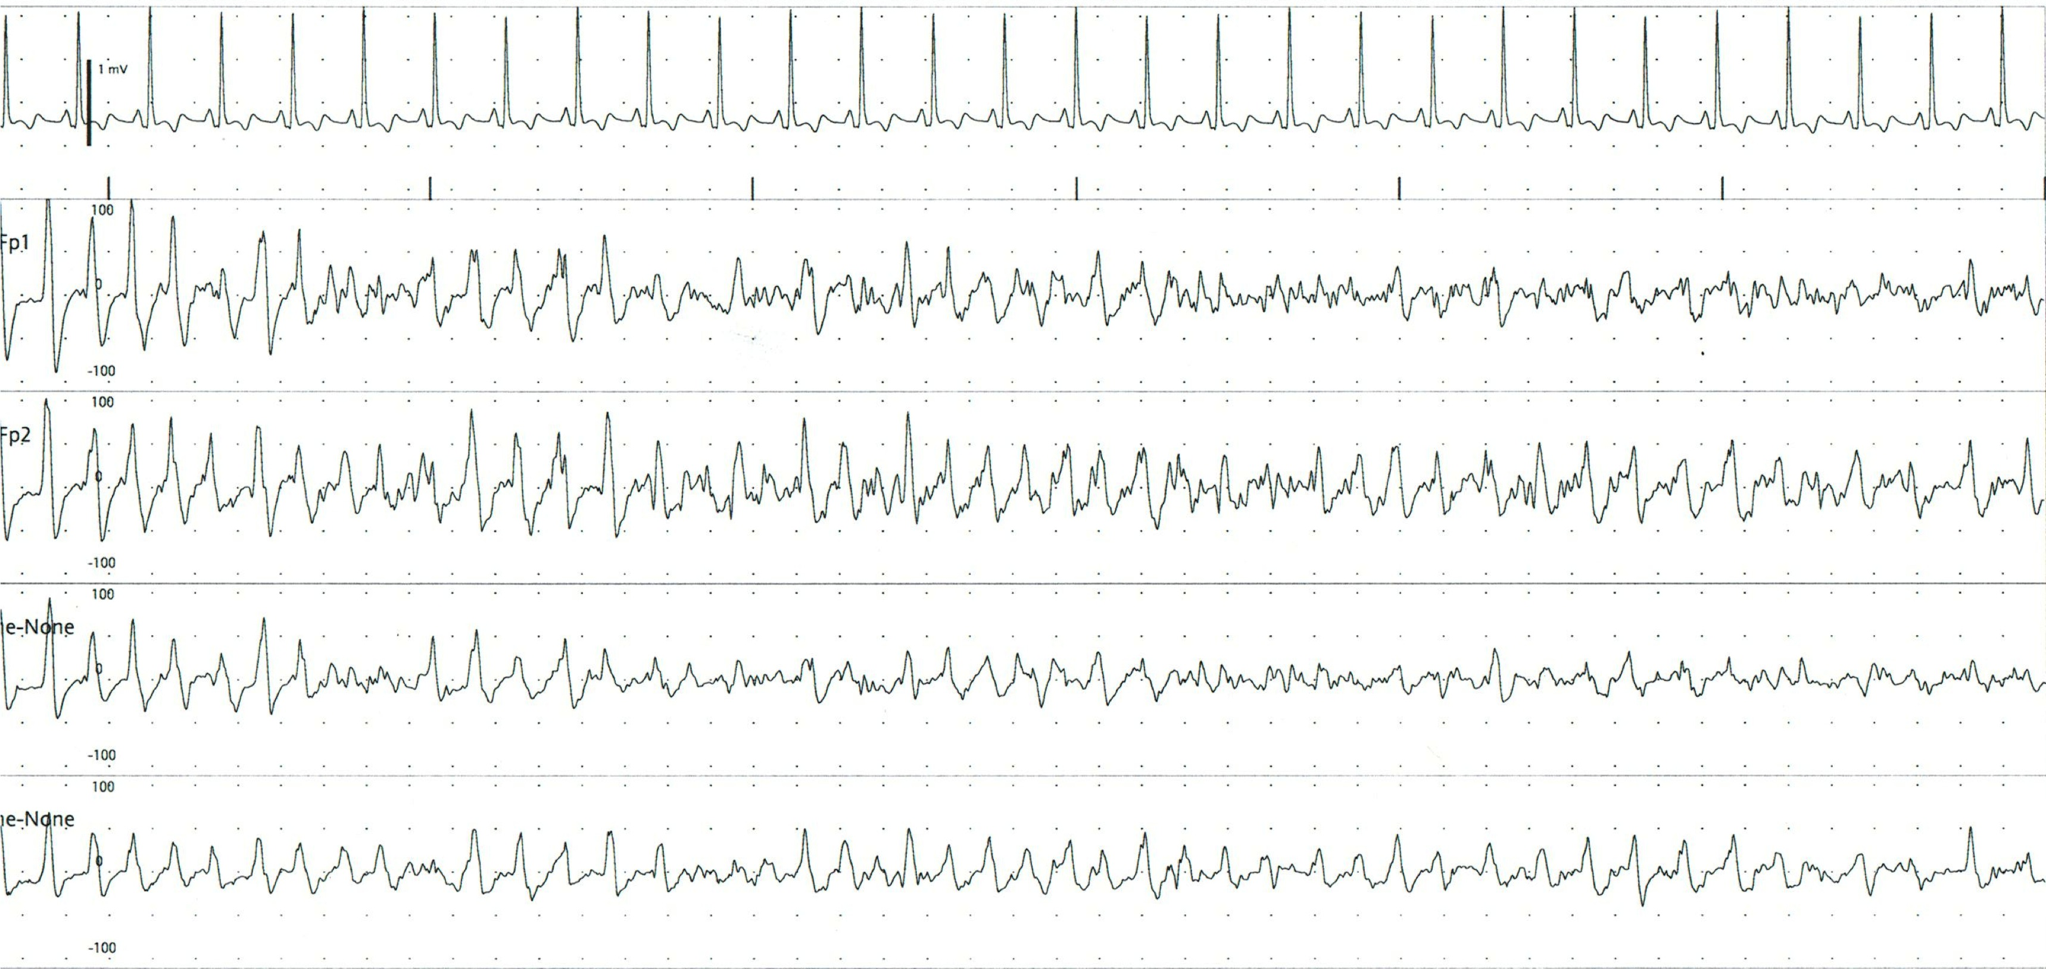
Generalised Non-convulsive Seizure

Slide 33
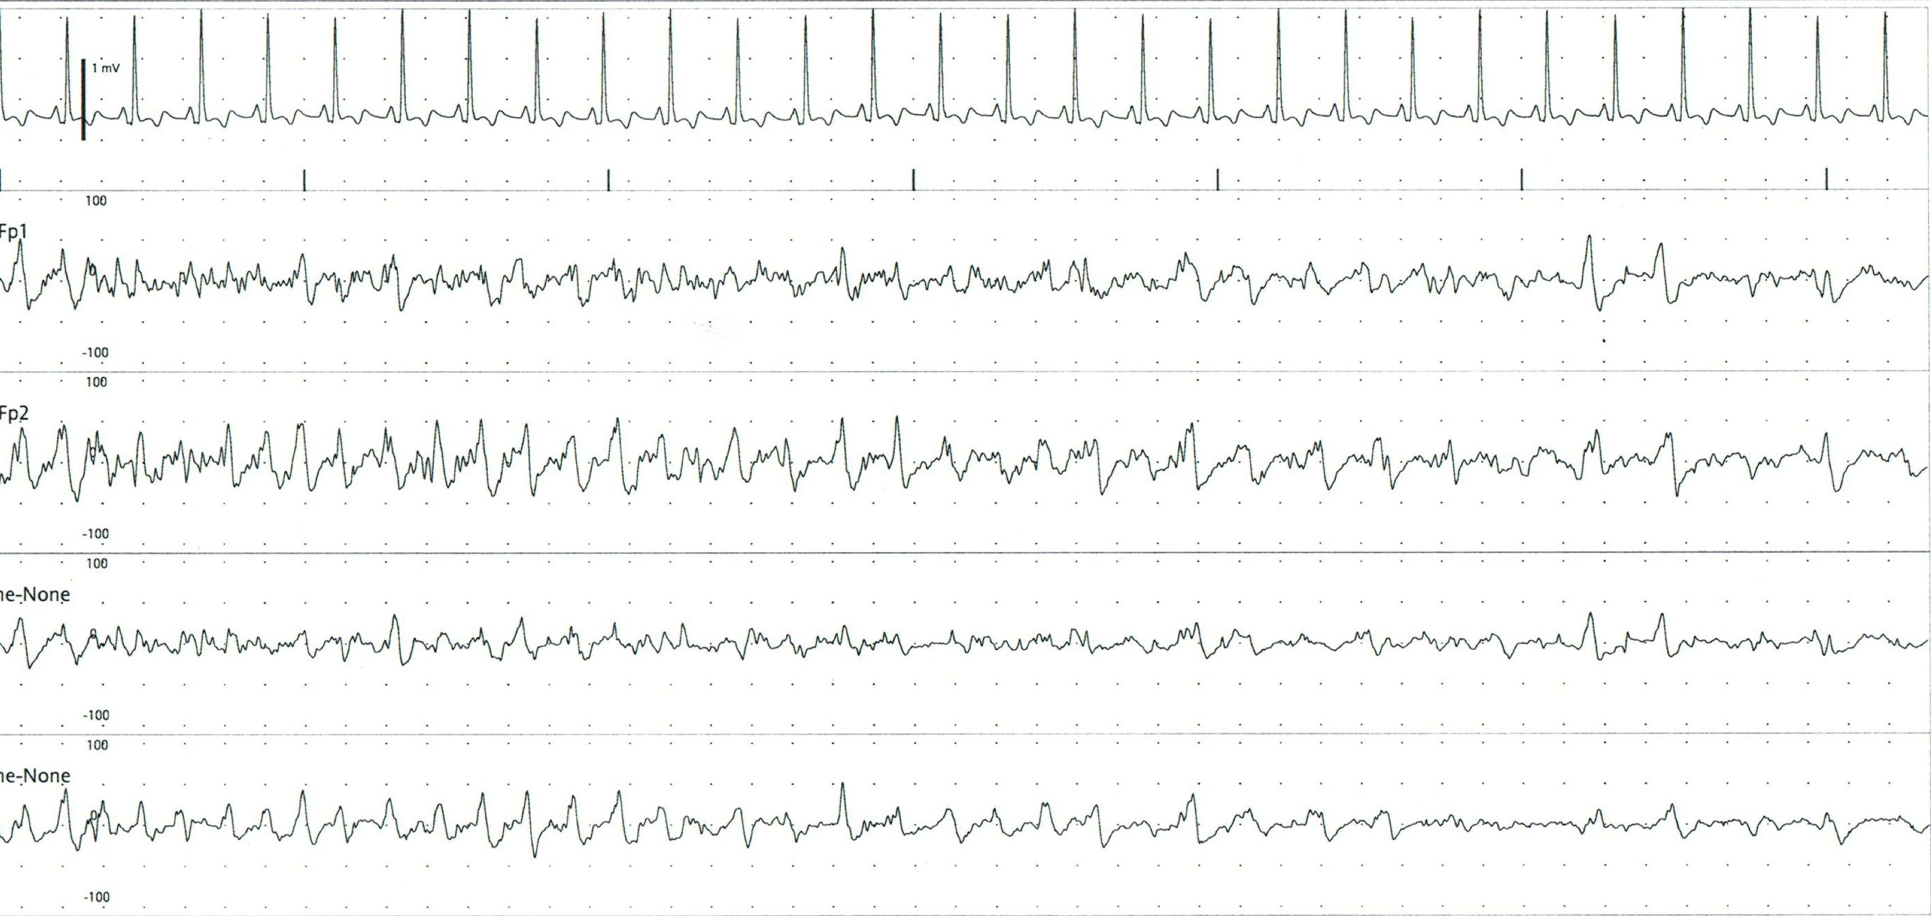
Generalised Non-convulsive Seizure

Slide 34
Focal Seizure
Onset in a focal region
May secondarily generalise to involve all cerebral regions

Slide 35
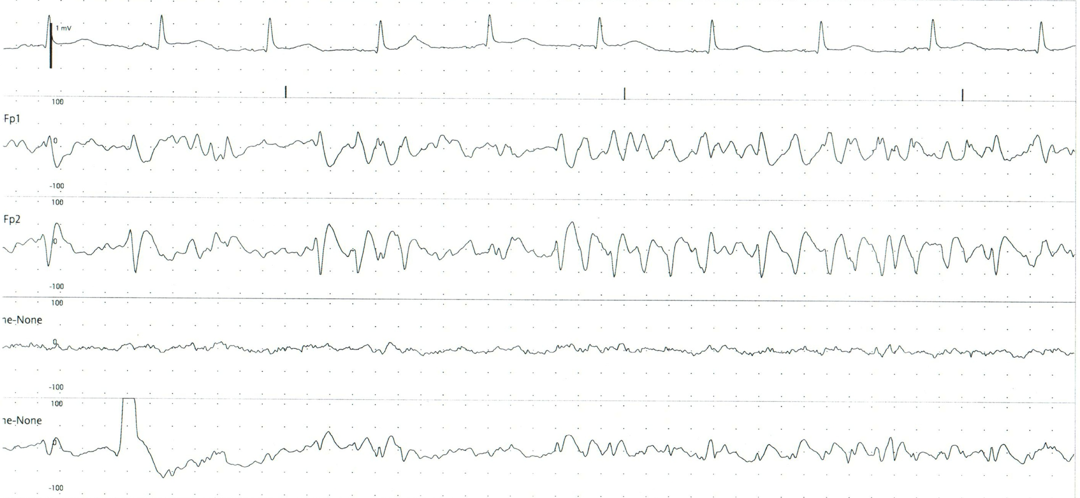
Focal Seizure
Right side predominant

Slide 36
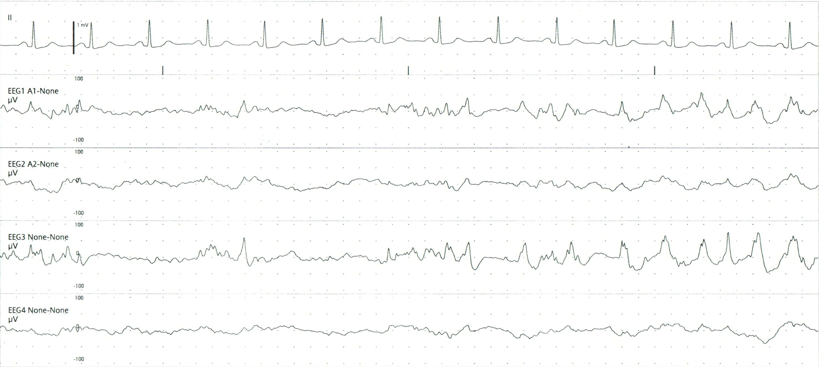
Focal Seizure 2

Slide 37
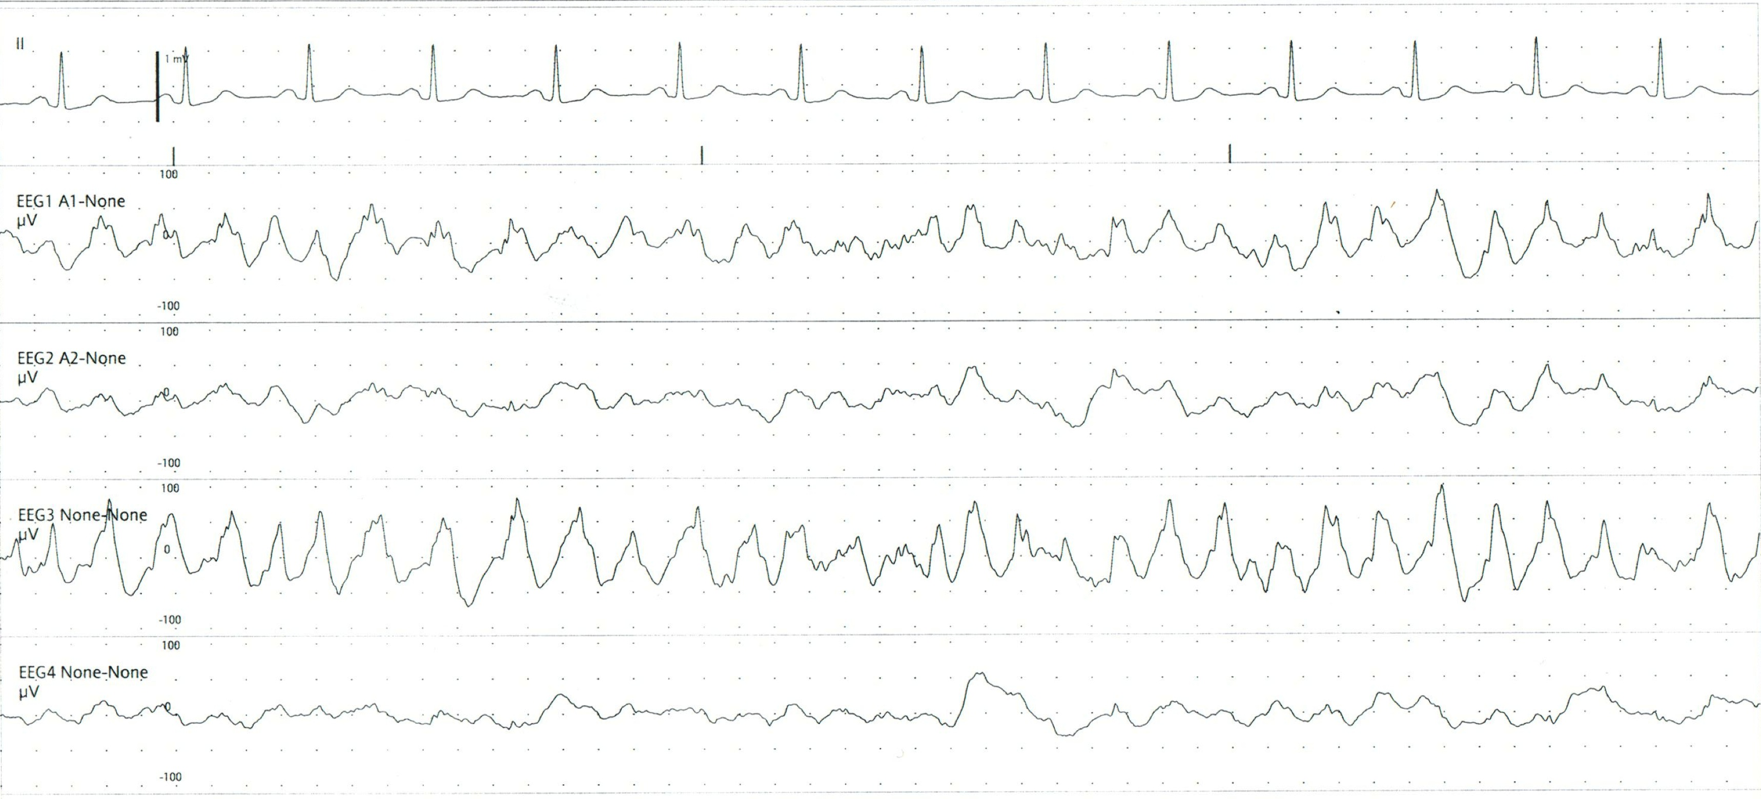
Focal Seizure 2

Slide 38
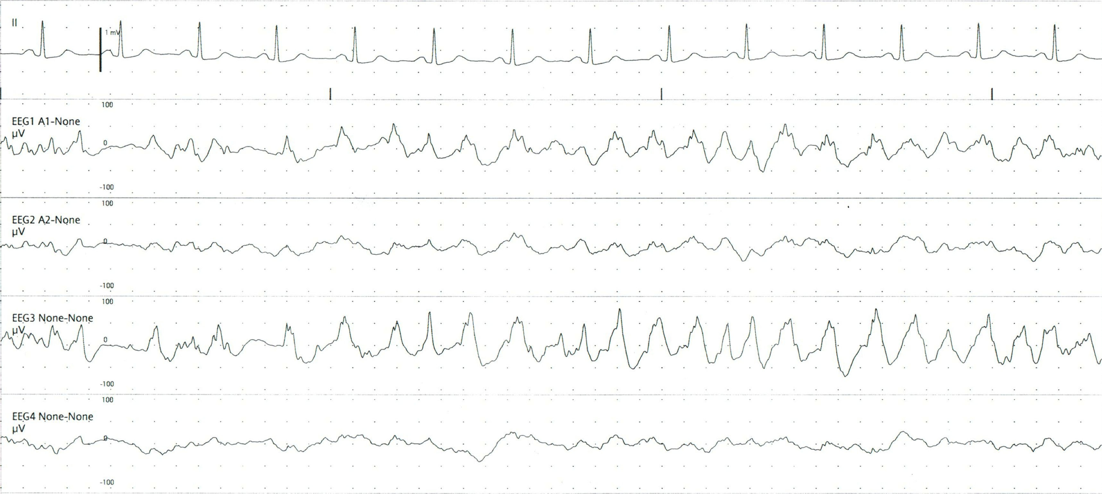
Focal Seizure 2

Slide 39
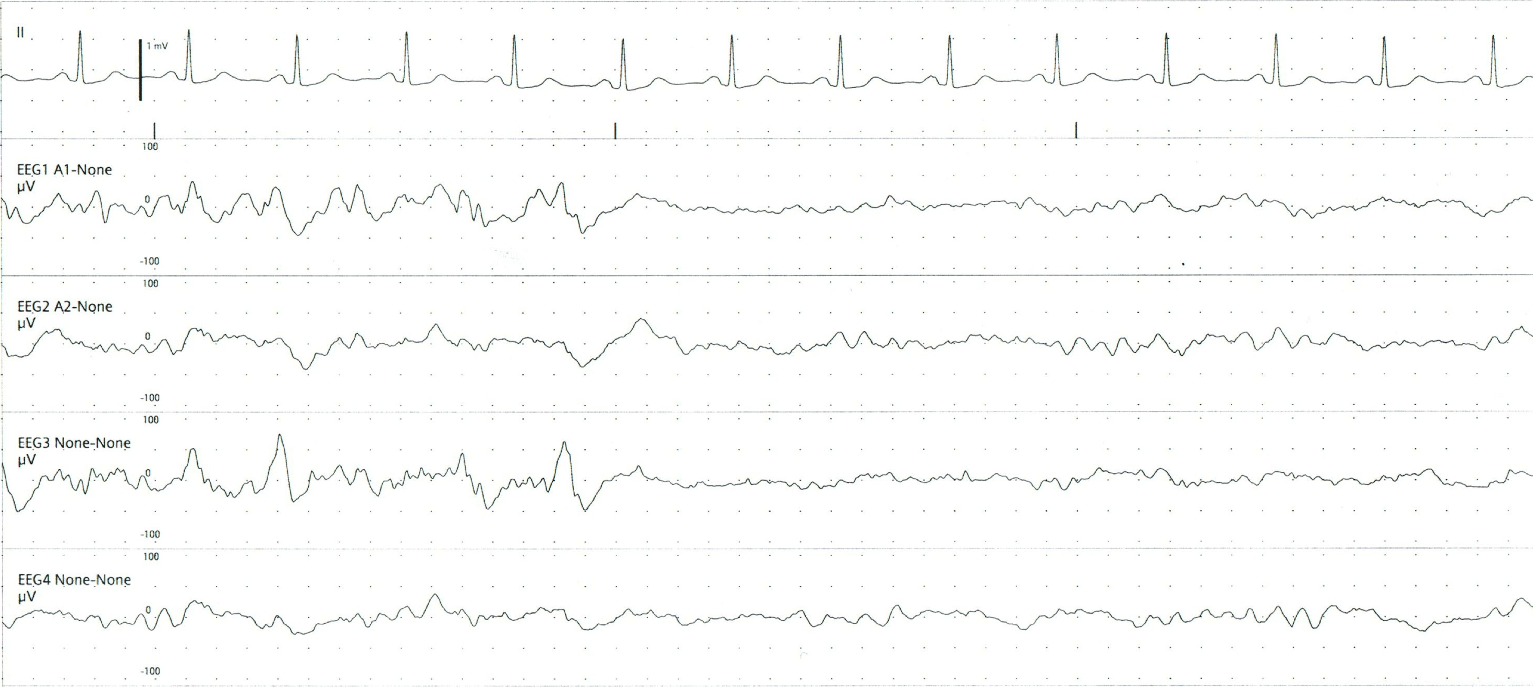
Focal Seizure 2

